Slide 1

A Foundational Step in Research Strategy – What is the Research Question?
Emily Coffman Richardson
Kinsearchers@gmail.com

Slide 2
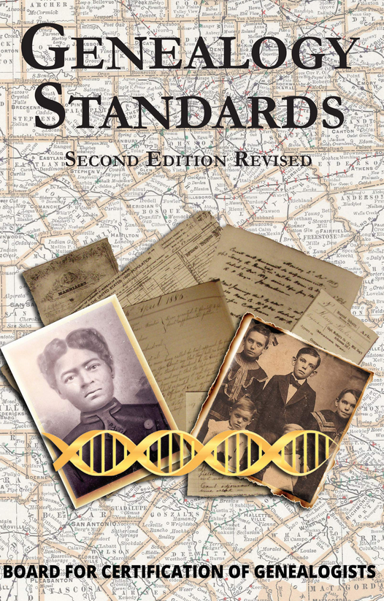

Slide 3
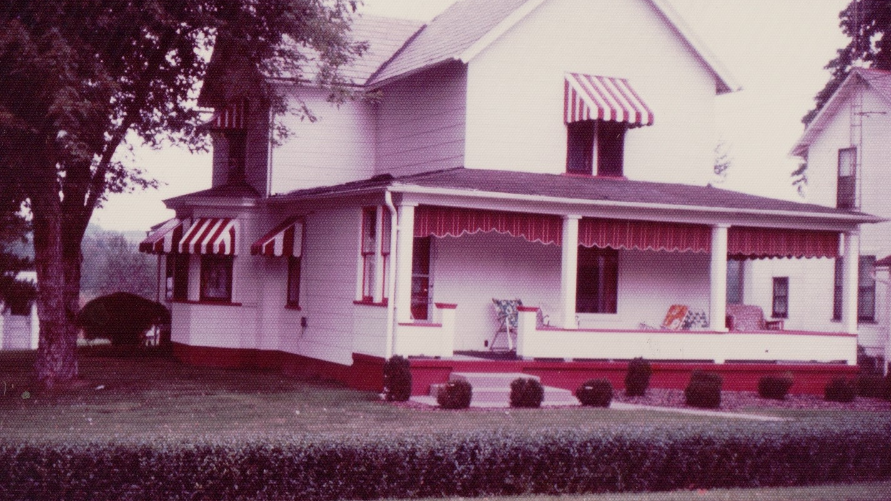
Must Start with the GPS
Genealogical Proof Standard¹
  Thorough Reasonably Exhaustive Research
  Complete Accurate Citations
  Process of Analysis and Correlation
  Resolution of Conflicts
  Written Statement supporting the Answer
1. Board of Certification of Genealogists, Genealogy Standards, Second Edition (Nashville, TN, 2019), P. 1-2

Slide 4
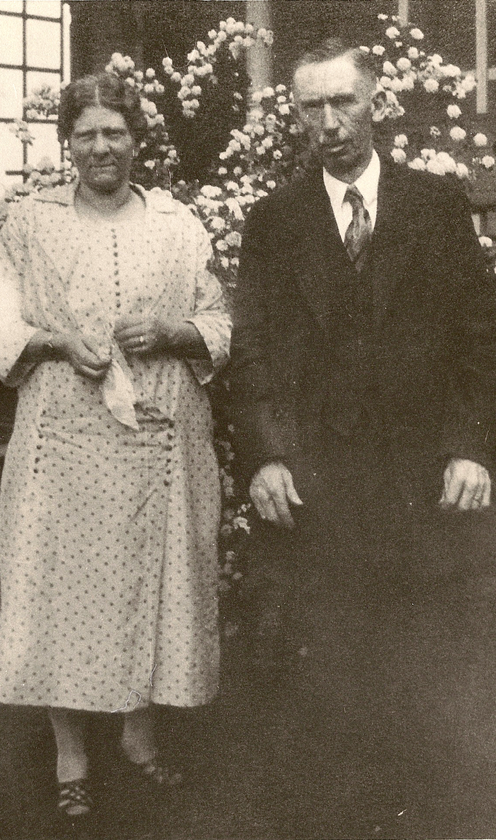
The Research Question starts the Reasonably Exhaustive Research

Slide 5
Reasonably Exhaustive Research
Yield at least two sources of independent information items agreeing directly or indirectly on a research question’s answer;
Cover sources competent genealogists would examine to answer the same research question;
Provide at least some primary information and direct, indirect or negative evidence from at least one original record;
Replace where possible, relevant authored narratives, derivative records, and information that is secondary or undetermined, and
Yield, where possible, data from sources that indexes and databases identify as potentially relevant.²
2. Board for Certification of Genealogists, Genealogy Standards, Second Edition (Nashville, TN, 2019), page 85.

Slide 6
Research begins with a Specific Research Goal
Research Question
Gather Evidence
Test Hypotheses
Establish Conclusions
Prove

Slide 7
If a writer asks no specific question worth asking, he can offer no specific answer worth supporting . . . . Serious researchers, however, do not report data for their own sake, but to support the answer to a question that they (and they hope their readers) think is worth asking.³
3. The Craft of Research, 3rd ed. (Chicago: University of Chicago Press, 2008), p. 41.

Slide 8

Effective Research Questions
“Questions underlying research plans concern aspects of identity, relationship, events and situations. The question are sufficiently broad to be answerable with evidence from relevant places and times. They are sufficiently focused to yield answers that may be tested and shown to meet or not to meet the Genealogical Proof Standard. Genealogical-research questions include (a) a clearly described unique person, group or event as the question’s focus; and (b) specification of unknown or forgotten information that the research is to discover (for example, an identity, relationship, event, or biographical detail).”⁴
4. Board for Certification of Genealogists, Genealogy Standards, Second Edition (Nashville, TN, 2019), p. 11-12.

Slide 9
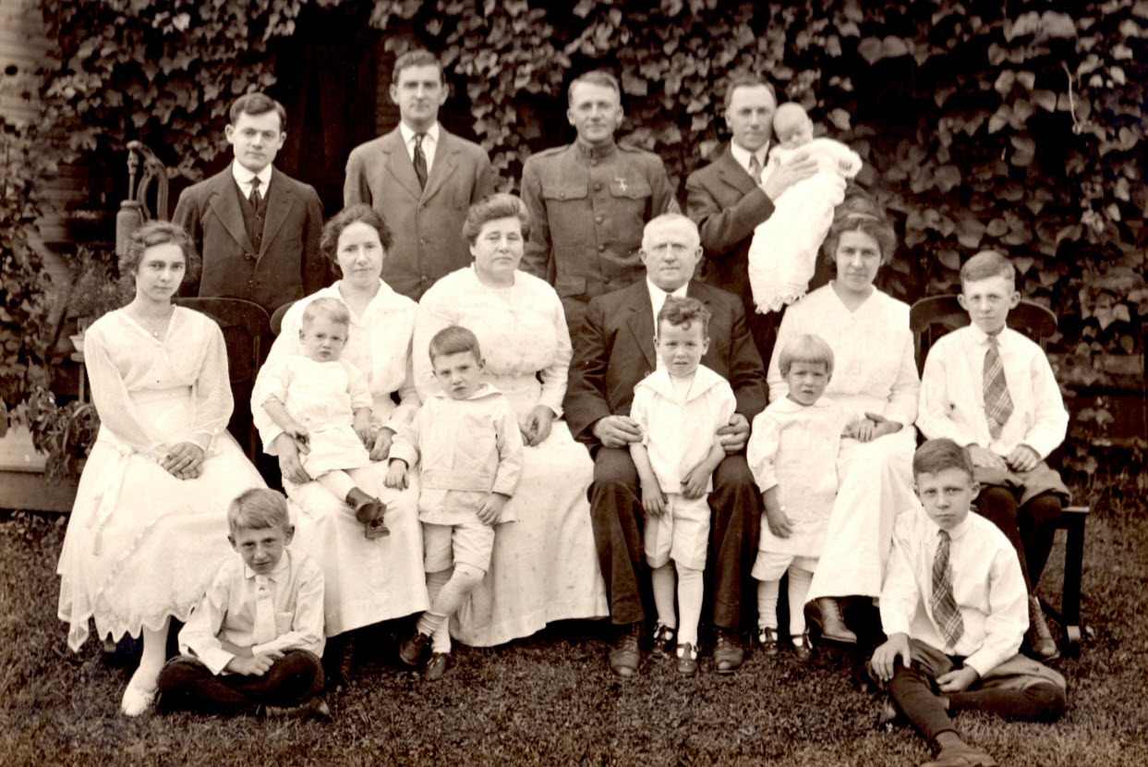
Identify the research subject
The research question must clearly identify a specific person of interest. And we need to identify this person to the exclusion of all other individuals with that name!

Slide 10
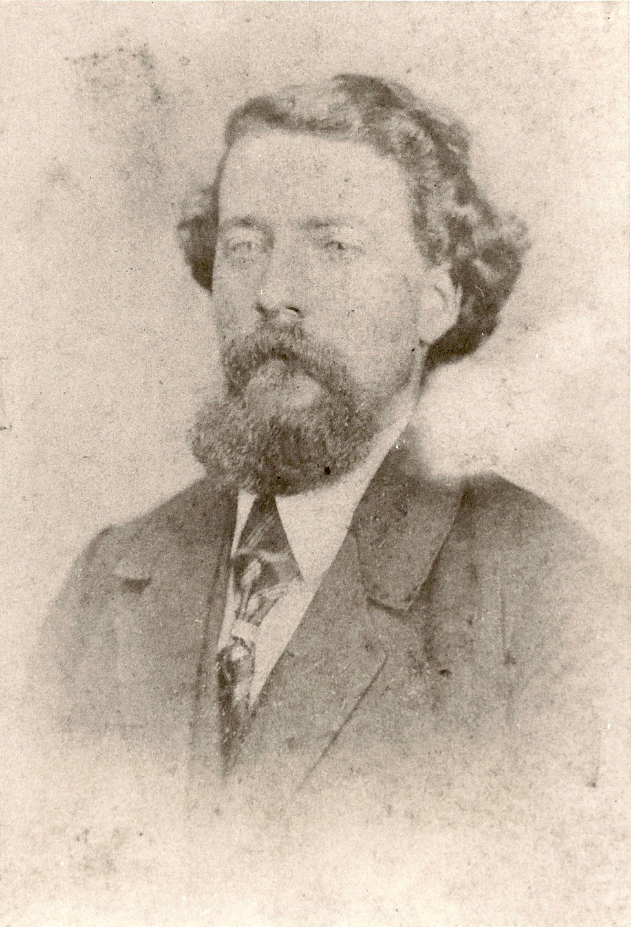
Grandfather?
Great – Grandfather?

Slide 11
An Example – Focus on Henry Fox
Johann Henrich Fuchs 1702-1790
Johann Henrich Fuchs (2) 1728-1772
Henrich “Henry” Fox 1760-1819
Henry “Heinrich” Fox 1791-1829
Henry Fox 1814-1854
Heinrich Fox 1816-1816
Henry E. Fox 1864 -
Virgil Henry Fox 1890-1977

Slide 12
Which Henry Fox?
Review all the current information you have on this individual to help you first define the person.
Henry Fox, 1814 – 1854 in Columbiana Ohio
  He married Lydia Jane Milbourn on 23 Jan 1840 in Columbiana County Ohio
  Henry is buried in Grove Hill Cemetery
  His probate names Lydia and children: Sarah Jane, Rosetha and George Fox

Slide 13
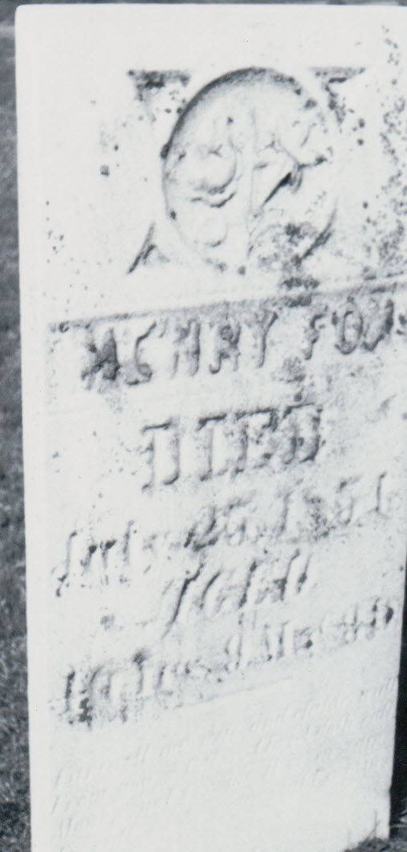
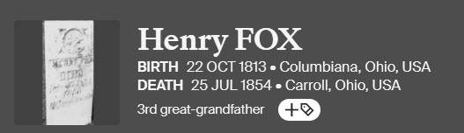
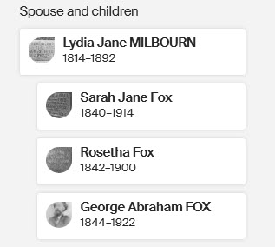
Grove Hill Cemetery
Hanoverton

Slide 14
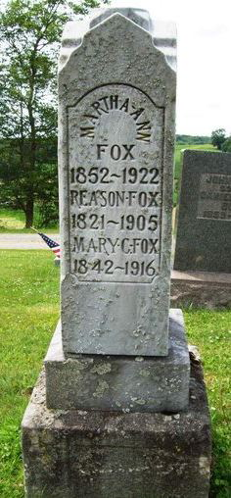

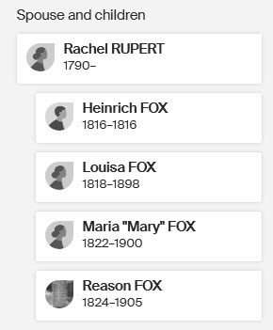
Grove Hill Cemetery
Hanoverton

Slide 15
Consider adding a timeline
Date | Event | Proof
1813- 1814 | Birth year | Tombstone
1840 | Census, Hanover, Columbiana County, Ohio - farmer | Census, Ancestry
1840 | Marriage to Lydia Ann Milbourn, Columbiana County, Ohio | MR, Ohio County Marriages, 1777-1993
1850 | Census, Goshen, Mahoning, Ohio farmer | Census, Ancestry
25 July 1854 | Notice of Death | Newspaper
 | Tombstone, Grove Hill Cemetery, 25 July 1854 age 40 y, 9m, 3d | Picture of Tombstone taken by mother
1856 | Probate process to sell lands | Case #4075, Columbiana County, Ohio

Slide 16
Identify what you want to know
A focused research question must identify a specific aspect of identity, relationship, event or situation concerning a specific person.
  Separating 2 men of the same name
  Identifying parents
  Location place of origin for an immigrant
  Maiden name of a married woman
  Military service
Remember – A research question must be answerable! Don’t look for vital records for a time period when they don’t exist

Slide 17
Three Basic Types of Questions
When and where did an event happen in an individual’s life?
  When did Andrew Giles of Lafayette County, Arkansas born in approximately 1840 die and where is he buried?
To whom was an individual related to by marriage or genetically?
  What was the maiden name of the wife of Jeremiah Giles, of Lafayette Arkansas who served in the Civil War?
What biographical details can be found about an ancestor?
  Did James Giles move to Texas to gain land as a result of statehood?

Slide 18
So, what do I want to know about Henry Fox?
Who are his parents?
The focused research question becomes:
Who are the parents of Henry Fox, born about 1814, married to Lydia Ann Milbourn in 1840, and who died on 25 July 1854 and is buried in Columbiana County, Ohio?

Slide 19
Does this meet the GPS?
“Genealogical-research questions include (a) a clearly described unique person, group or event as the question’s focus; and (b) specification of unknown or forgotten information that the research is to discover (for example, an identity, relationship, event, or biographical detail).”
Who are the parents of Henry Fox, born about 1814, married to Lydia Ann Milbourn in 1840, and who died on 25 July 1854 and is buried in Columbiana County, Ohio?

Slide 20
This focus helps to:
Plan the research
  Possible parents in 1810, 1820, 1830 census in Columbiana County, Ohio
    Johann Christopher Fox
    Johann Michael Fox
    Johann Philip Fox
  Church records for his birth, that might name parents
  Land records around 1840 resulting in land (he was a farmer in 1840 census)
    Might name his father
  Probates of other Fox men between 1814 and 1850 in Columbiana County, Ohio that list him as a son
  DNA

Slide 21
Willing to hear the story?
Who are his parents?

Slide 22

Reviewing the first Fox in the Community
Johann Christopher Fox (unknown relationship to Heinrich or Michael)
  Will names sons: John Peter and Jacob
  No HENRY!!

Slide 23
2nd Fox’s in the Area
Johann Michael Fox –
  Brother of Henrich “Henry” Fox (1760-1818)
    Based on land and movement
  Married Hannah
  Michael dies on August 1821 – old enough to have a son Henry; but - -
  Will names: Catherine, Abraham, Mary, Rebecca, John, Anna, David, Samuel and Tobias

Slide 24


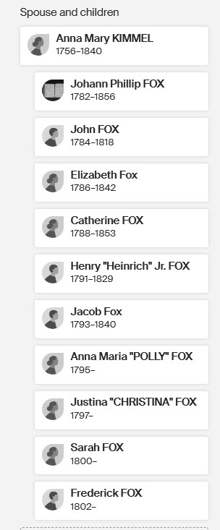

Slide 25
Third Fox: Johann Philip Fox
Philip is the oldest son of Henrich “Henry” Fox, 1760-1918
Only 1 census (1850) with names
Probate in 1856
Marries 1st Susanna Hoffman
  2 children: Samuel and Sarah (Sally)
Marries 2nd Sarah Roller
  Catherine, Philip, John, Lavinia and Josiah are named.
  Could Henry be another child (born 1813, Sarah born 1812, Catherine born 1815)

Slide 27
Henrich “Henry” Fox 1760-1819
  Married Anna Mary (2nd marriage)
  Came to Ohio in 1806
  Son, Johann Phillip Fox, baptized in PA in 1782
  Son, Henry Fox, baptized in PA in 1791 – had a son Henrich who died at birth (1816)
  Phillip, Henry, Jacob, Catherine, Elizabeth, Sally, Eustina, Mary, Frederick – all were part of a deed granting Mary Fox (wife) the rights to Henrich’s plantation
  Son, John dies in 1818; probate offers children names = 5 girls; 1 son (Joseph)
  Son, Frederick in 1819, was under guardianship, therefore could not be a father to Henry born in 1814.
  Son, Jacob had a son Heinrich in 1834

Slide 28
Johann Philip Fox
Johann Philip Fox – Son of Heinrich “Henry” Fox
  Died in 1856
  Land and assets were sold by court to pay his debts
  No children named in file
  Wife not mentioned by name but received $81.12
  Know his wife is Sarah (at his death) based on a baptism record for a son Philip Fox Jr
  Samuel Fox (son by first wife) and Andrew Milbourn were administrators

Slide 29
Revisit the timeline for subject “Henry”
Date | Event | Proof
1813- 1814 | Birth year | Tombstone
1840 | Census, Hanover, Columbiana County, Ohio | Census, Ancestry
1840 | Marriage to Lydia Ann Milbourn, Columbiana County, Ohio | MR, Ohio County Marriages, 1777-1993
1850 | Census, Goshen, Mahoning, Ohio | Census, Ancestry
25 July 1854 | Notice of Death | Newspaper
 | Tombstone, Grove Hill Cemetery, 25 July 1854 age 40 y, 9m, 3d | Picture of Tombstone taken by mother
1856 | Probate process to sell lands | Case #4075, Columbiana County, Ohio

Slide 30
DNA Results
Johann Philip Fox (26 matches)
Henry Fox
Josiah Fox
Clifford Fox
George Fox
Eva Fox
Ross Fox
George Fox
Fern Fox
Dorothy Yoder
Author
Gladys Fox
Match 1
George F Fox
Match 4
George Hill
Ernest Hill
Charles Hill
Match 6
Mary L Hill
Private
Match 5
Charlotte Fox
Match 3
Fred Robison
Match 2

Slide 31
Why is this important?
Johann Heinrich Fuchs (1728-1772)
Henry “Heinrich” Fox, 1760 (Kimmel)
Henry “Henrich” Fox, 1791(Rupert)
Reason Fox (Hoffee)
Johann Philip Fox, 1782 (Roller)
Walter Abraham Fox (Fox) ggf
Henry Fox, 1814 (Milbourn)
George Abraham Fox (Coombs)
Eva Leona Fox ggm

Slide 32
The Research Question starts the Reasonably Exhaustive Research

Slide 33
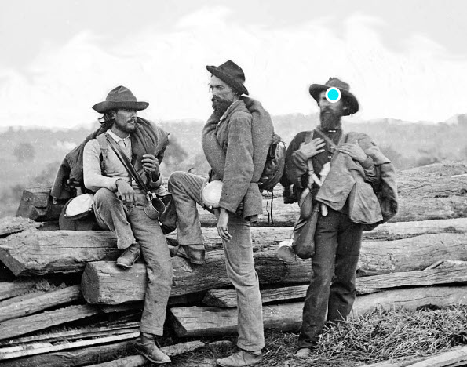
Let’s use another example
Based on a death certificate from 1919, Waitman E. Hess parents are listed as Eliza Davis and Martin Hess.
Waitman died in Georges, Fayette County, Pennsylvania
He was born 31 July 1863
The client wants to know if Martin Hess served in the Civil War.

Slide 34
What do we already know about Martin Hess or Eliza Davis?
Martin and Eliza are named in Waitman’s death certificate
Martin and Eliza are listed as parents on Waitman’s marriage record
1860 Census, Eliza E is shown as 18 living in household of Bowen Davis and Eliza Davis; older brother of 22 is Waitman
1870 Census, Ellen Hess is living in household of Bowen and Eliza Davis with a child William Hess age 3; Wm E Hess is living (age 6) with his aunt Mary Lucas, nearby.
1880 Census, L.E. Hess is shown as 28, living with Bowers and Liza Davis; listed as widowed; W.E. and William listed as grandchildren (last name listed as Davis; not Hess)

Slide 35
So, Let’s Craft the Question
“Genealogical-research questions include (a) a clearly described unique person, group or event as the question’s focus; and (b) specification of unknown or forgotten information that the research is to discover (for example, an identity, relationship, event, or biographical detail).”
Did Martin Hess (died prior to 1880), listed as the husband of Eliza Davis on multiple documents in relation to two sons (Waitman and William), serve in the Civil War? When and where did Martin Hess die?

Slide 36
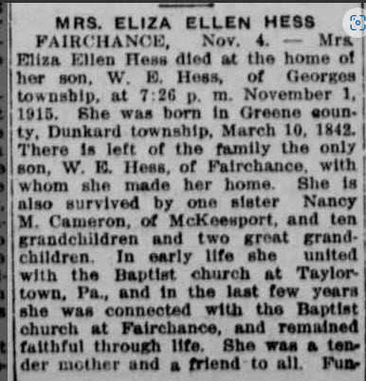
So, Design the Research Plan?
Remember – although we know Martin is listed as father – he never seemed to have lived with Eliza Davis during census enumeration.
  Civil War Records
  Newspapers

Slide 37
More Comparison – 1850 Census
NO | Martin Hess | 97th Regiment | Private Pension | Mary Garner, Buried Lebanon, PA
NO | Martin D Hess |  | Married Catherine Lehn, buried Lancaster | Muster in Lancaster
Prob NO | Martin B Hess | 122nd Regiment | Wagoner (Harrisburg) But recruited in Lancaster
NO | Martin Hess | 128th Regiment | Private, was 18 in 1862 Pension | Died 20 Oct 1862
NO | Martin B Hess | 3rd Heavy Artillery | Private | Philadelphia Muster Roll
Prob No | Martin P Hess | 98th Regiment | Private Philadelphia
 | Isaac Martin Hess | Co I, 7 Regiment, OHIO
NO | Martin Hess |  | Muster 1 July 1863; age 24; farmer; unmarried Buried Kansas! Married Ida Cromwell after war | Westmoreland/ Fayette

Slide 38
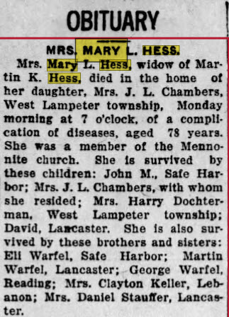
NO | Martin K Hess | 50th PA Militia | Private Lancaster 23 Aug 1901 | Mary Warfel

Slide 39
Final Results
Still working on this one!
Focus is staying present to question
If not Civil War – what happened to Martin Hess
Still need local newspapers

Slide 40
Reminders about Research Questions
You won’t have only one question about a subject! In fact, your research might answer other questions but stay focused on the question you originally ask!
Focused questions don’t allow you to chase BSO’s (Bright Shiny Objects!!)

Slide 41
Next Step after the Question
Determine the resources that can answer the question
  Location Based resource guides (FamilySearch WIKI)
  Records pertinent to the location
  Books: WorldCat and FamilySearch Books
  Historical Societies and libraries
  Vital Records
  Census Records
  And the list goes on;
  Use a Timeline and review your records

Slide 42
Research begins with a Specific Research Goal
Research Question
Gather Evidence
Test Hypotheses
Establish Conclusions
Prove

Slide 43
My Current Research Questions?
Who is the mother of James Hamilton Combs, 1824-1880, who lived in Stark County, Ohio and whose father was Charles C. Combs?
Who are the parents of Peter Miller who lived in Washington Co, MD and died in 1818 and whose will was executed in front of Lancelot Jacques Jr. and Harry Prather?

Slide 44

Questions?
Emily Coffman Richardson
Kinsearchers@gmail.com

