Slide 1
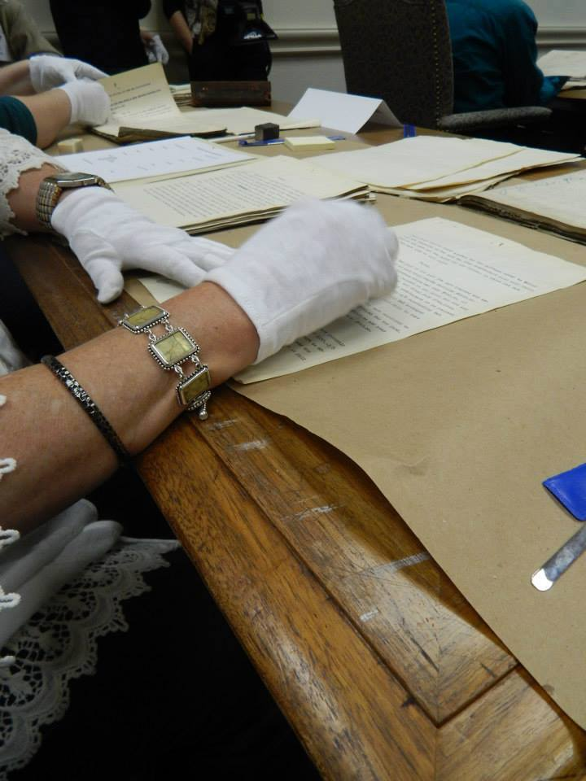
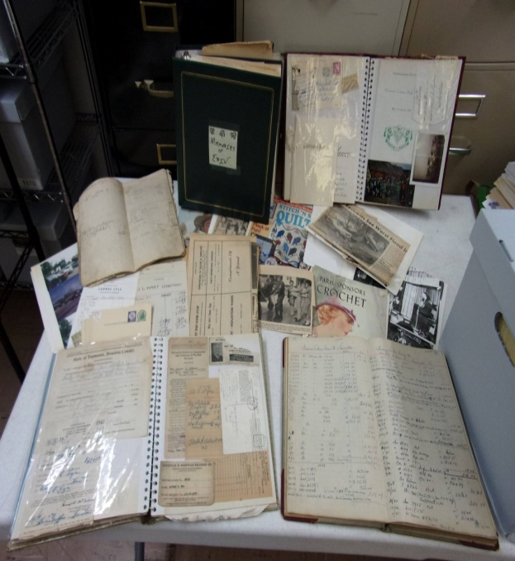
Preserving Documents and Ephemera
By
Melissa Barker
Certified Archives Manager
Houston County, TN. Archives & Museum
Professional Genealogist
© Copyright 2025 Melissa Barker. All Rights Reserved

Slide 2
Genealogists are Home Archivists!

Slide 3
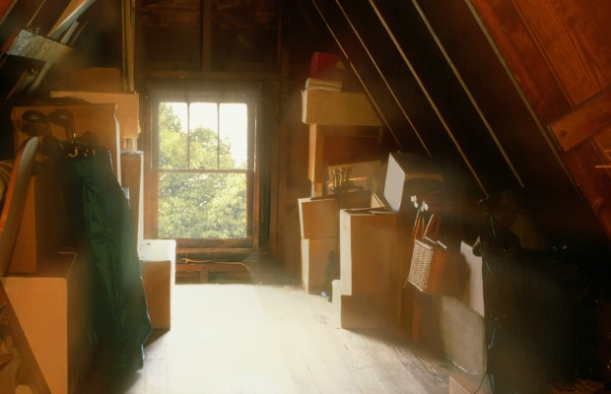
Genealogists are Home Archivists
Collect old records

Slide 4
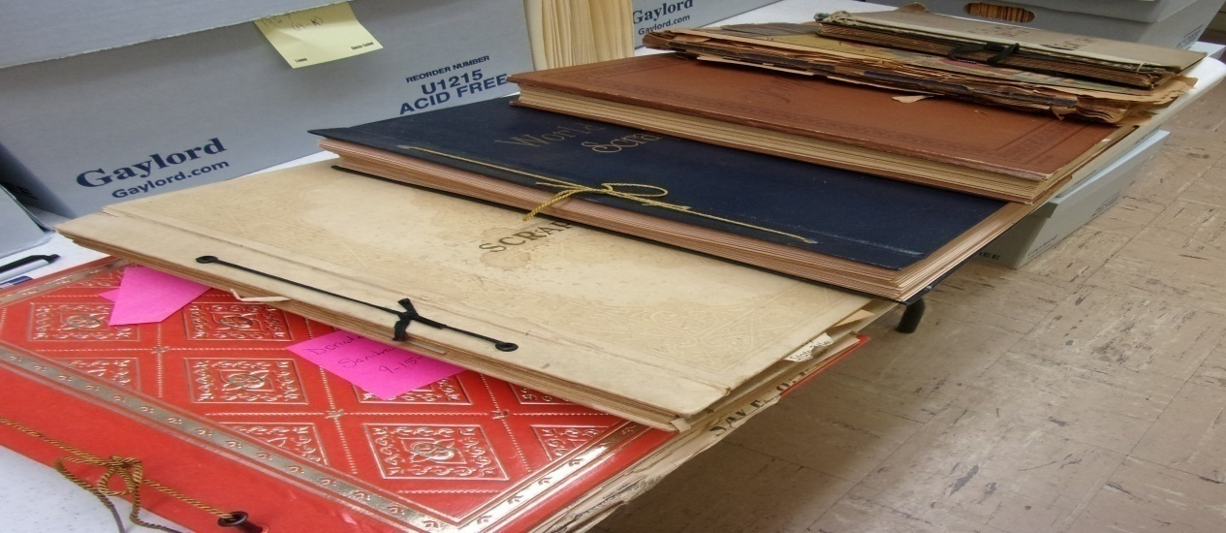
Genealogists are Home Archivists
Collect old records
Preserve records, photographs and artifacts for future generations to enjoy

Slide 5
Genealogists are Home Archivists
Collect old records
Preserve records, photographs and artifacts for future generations to enjoy
Share information and records with researchers

Slide 6
Genealogists are Home Archivists
Collect old records
Preserve records, photographs and artifacts for future generations to enjoy
Share information and records with researchers
Love the stories these records tell!

Slide 7
Home Archivist Tools to Preserving Documents and Ephemera
A Dedicated Working Space
Original Order
Ephemera, What is it?
Binders, Folders or Boxes
Unfolding and Flattening Records
Cleaning Records
Removing Hazards
Records Storage and Climate Controls
Consulting with a Conservator

Slide 8
A Dedicated Working Space

Slide 9
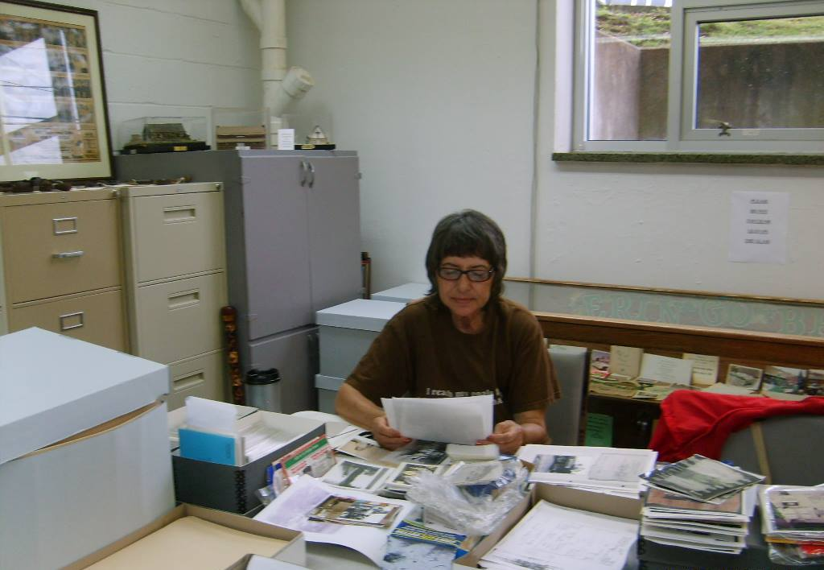
A Dedicated Working Space
Home Archivists should have a dedicated space to work on records organization and preservation
Anne Sykes (1949-2016), Volunteer Houston County, TN. Archives

Slide 10
A Dedicated Working Space
Home Archivists should have a dedicated space to work on records organization and preservation
Have the Home Archivist Tool Kit at the ready

Slide 11
A Dedicated Working Space
Home Archivists should have a dedicated space to work on records organization and preservation
Have the Home Archivist Tool Kit at the ready
Work on one collection of records at a time

Slide 12
A Dedicated Working Space
Home Archivists should have a dedicated space to work on records organization and preservation
Have the Home Archivist Tool Kit at the ready
Work on one collection of records at a time
Clean up your space at the end of the day

Slide 13
Original Order

Slide 14
Original Order
Defined as:
Original Order is a fundamental principle of archives. Maintaining records in original order serves two purposes:
First, it preserves existing relationships and evidential significance that can be inferred from the context of the records.
Second, it exploits the record creator's mechanisms to access the records, saving the archives the work of creating new access tools.
Source: Society of American Archivist Glossary of Terms: https://www2.archivists.org/glossary

Slide 15
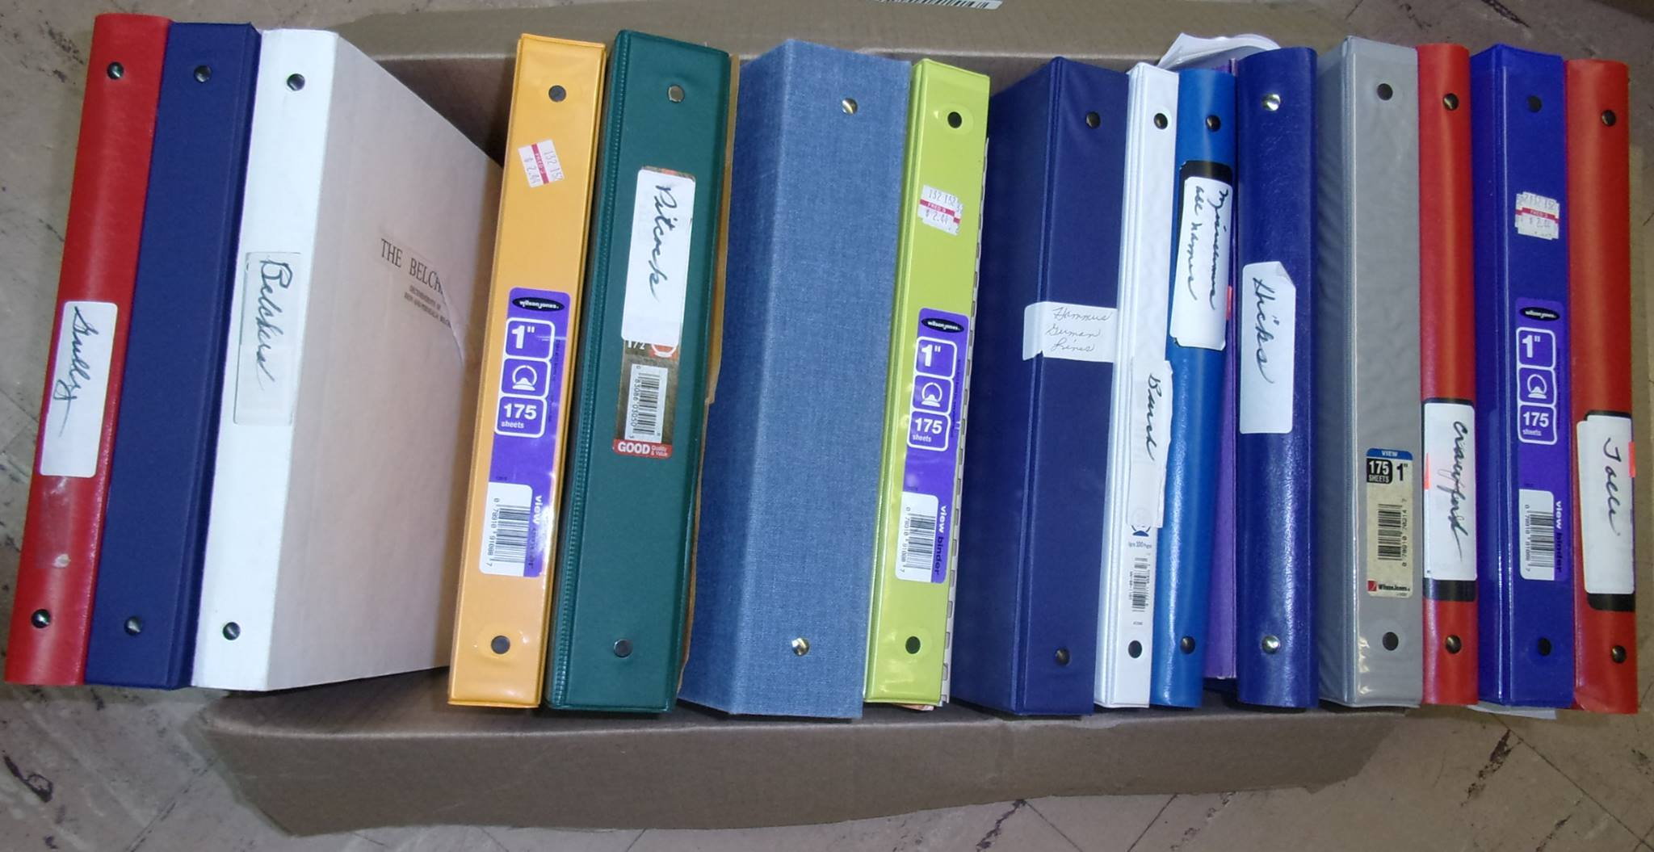
Original Order
Our ancestor may have a reason for how they put together that scrapbook or photo album

Slide 16
Original Order
Our ancestor may have a reason for how they put together that scrapbook or photo album
Boxes of records may have been packed a certain way for a reason

Slide 17
Original Order
Our ancestor may have a reason for how they put together that scrapbook or photo album
Boxes of records may have been packed a certain way for a reason
Keeping original order could help us tell our ancestor’s story in sequence

Slide 18
Ephemera, What is It?

Slide 19
Ephemera, What is it?
Ephemera: Materials, usually printed documents, created for a specific, limited purpose, and generally designed to be discarded after use. (Source: Society of American Archivist Glossary of Terms)

Slide 20
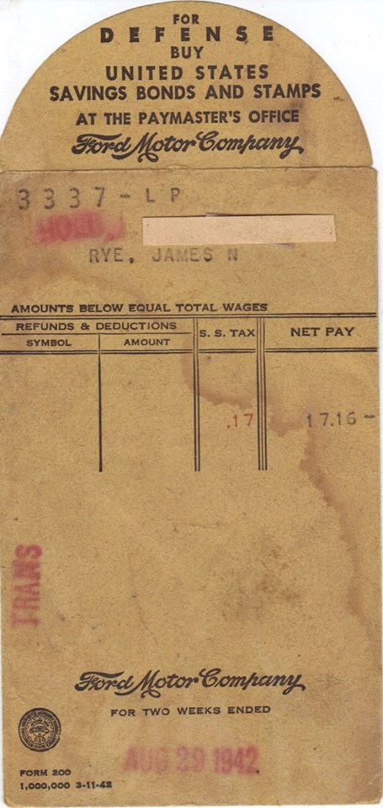
Ford Motor Company Pay Envelope for James N. Rye
August 29, 1942
Houston County Archives & Museum

Slide 21
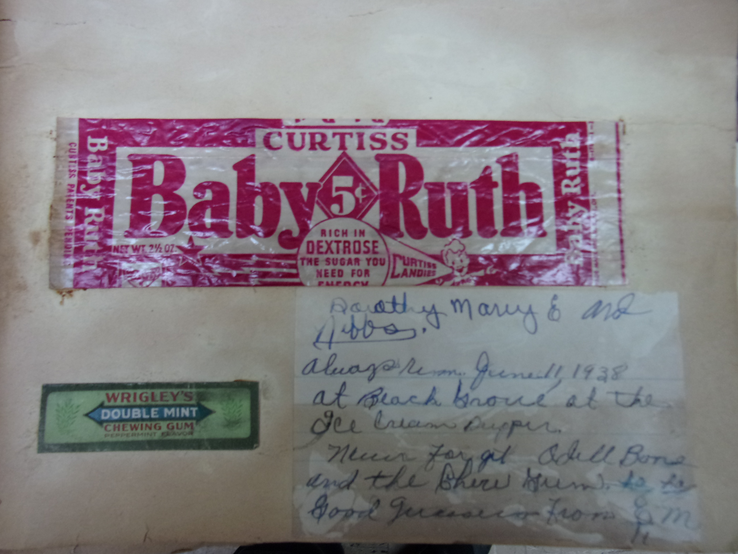
Evelyn Ellis Scrapbook, June 11, 1938, Houston County Archives & Museum

Slide 22
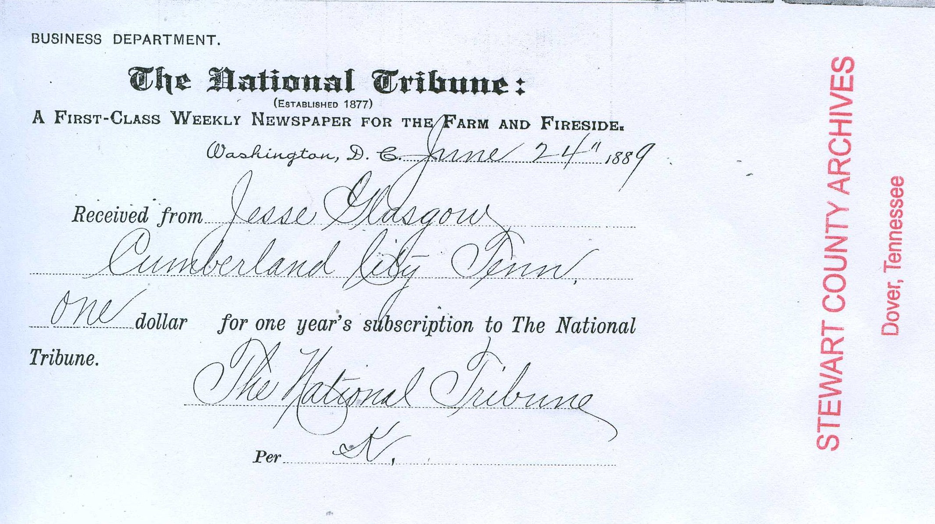
Jesse Glasgow, Receipt for Newspaper Subscription June 24, 1889, Melissa Barker Personal Archive

Slide 23
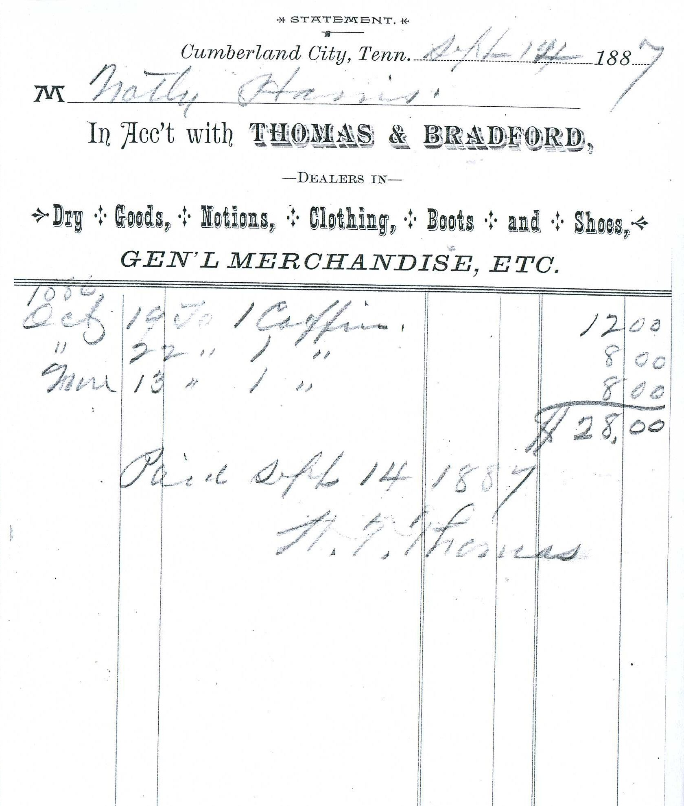
Notley Harris, Store Receipt
September 14, 1887
Melissa Barker Personal Archive

Slide 24
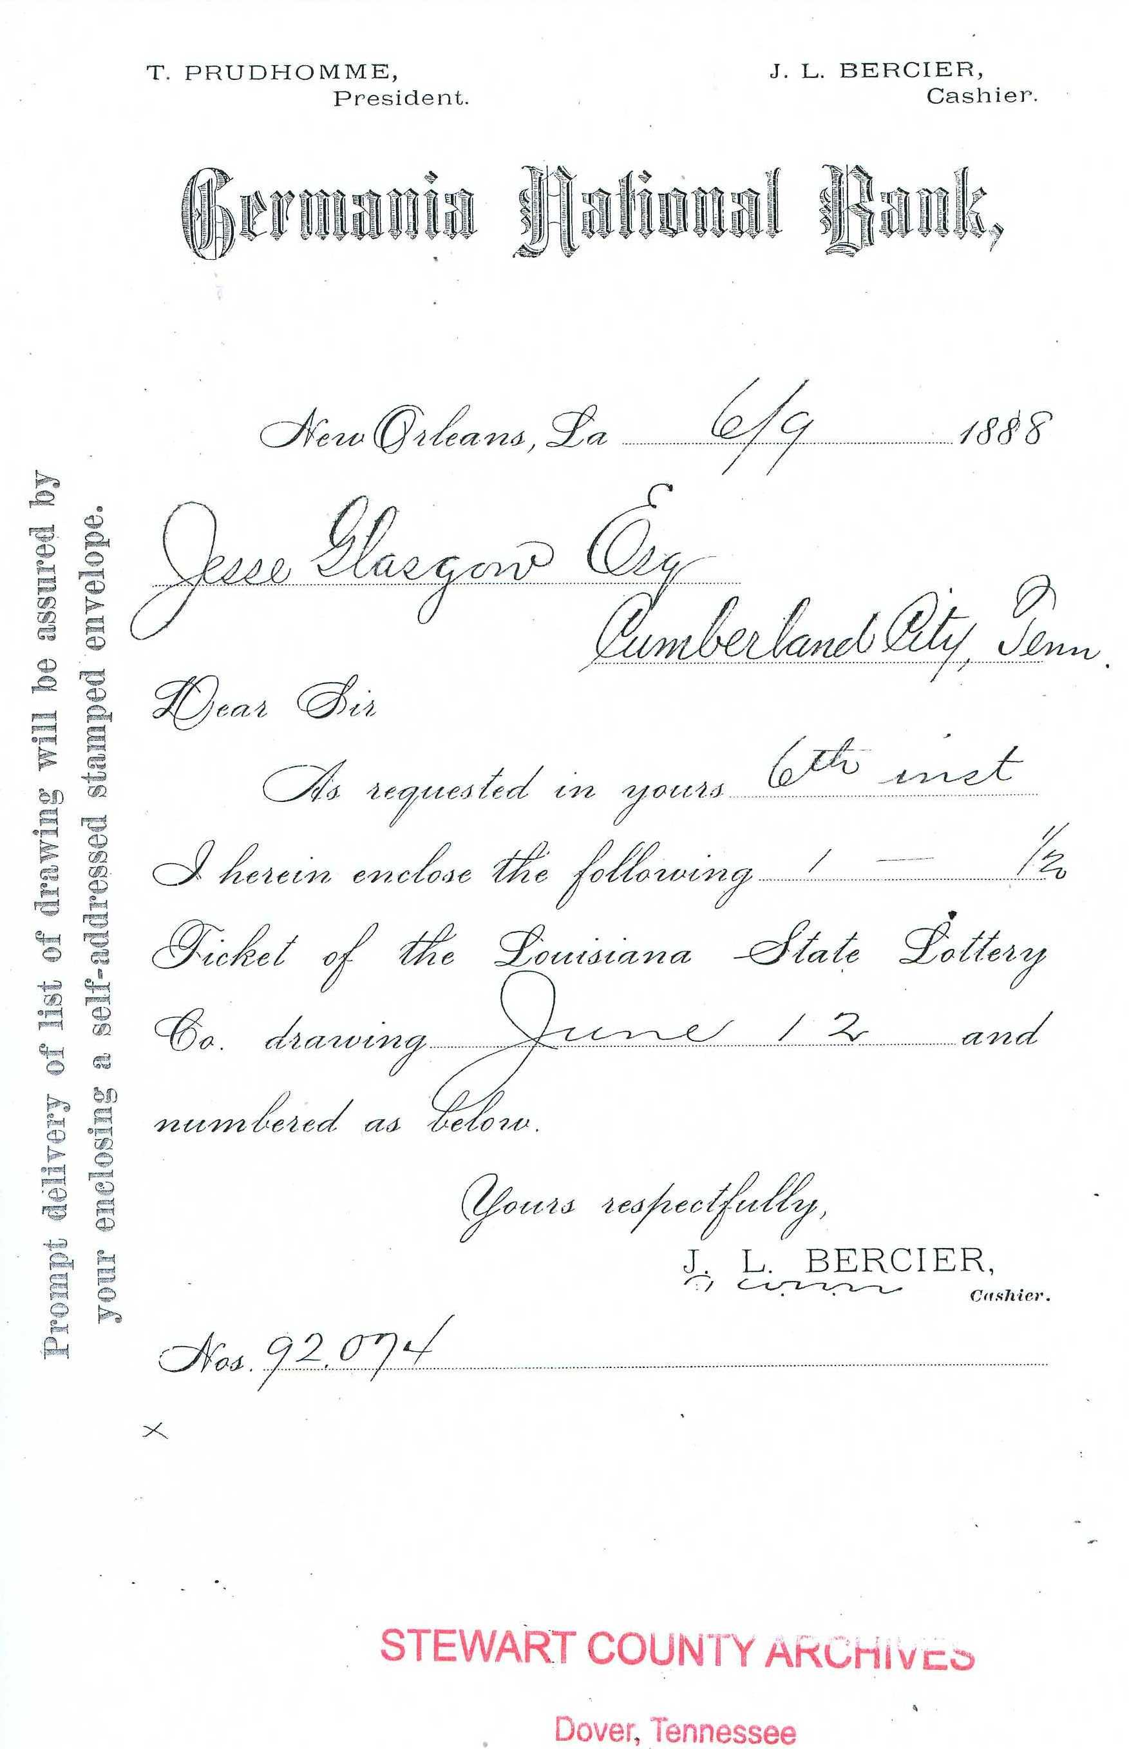
Louisiana State Lottery Ticket
June 9, 1888
Jesse Glasgow
Melissa Barker Personal Archive

Slide 25
Organizational Methods for Documents and Ephemera

Slide 26
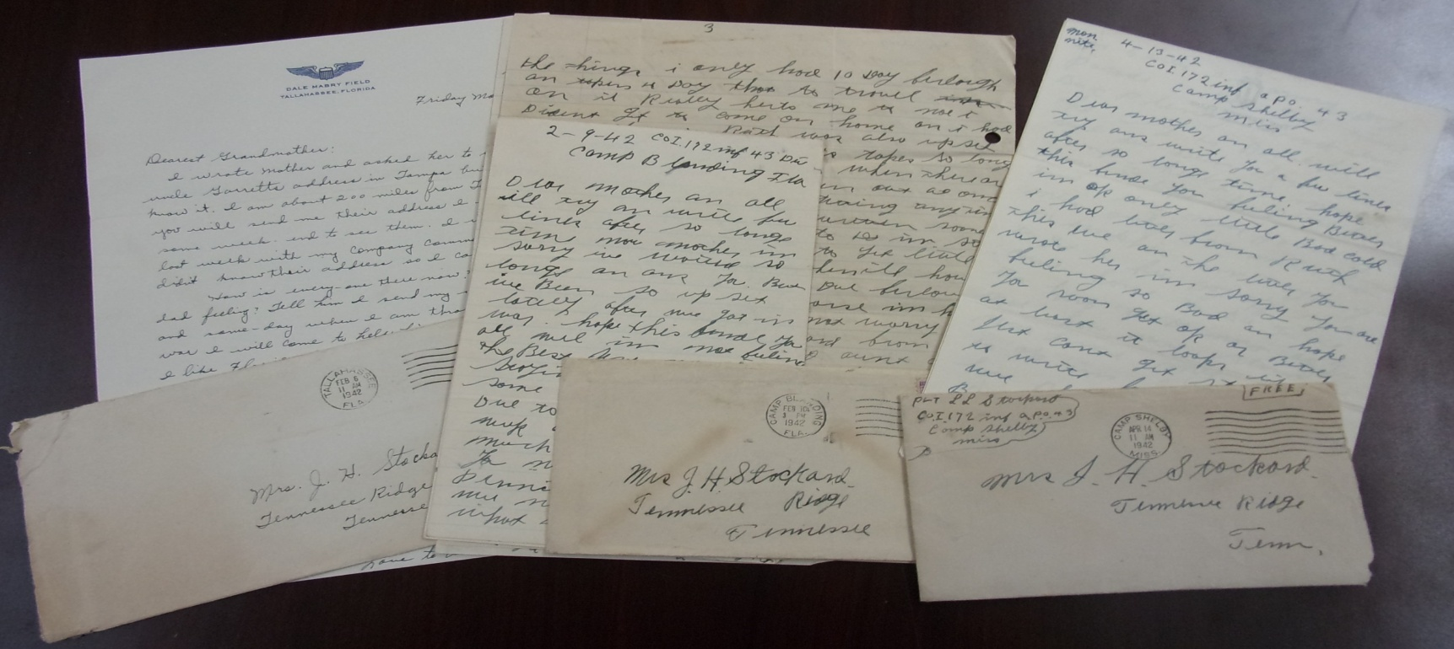
Organizational Methods
Choose a method that works well for you, what works for someone else may not work for you

Slide 27
Organizational Methods
Choose a method that works well for you, what works for someone else may not work for you
Whatever method you choose, be consistent and use that method for all your records

Slide 28
Organizational Methods
Choose a method that works well for you, what works for someone else may not work for you
Whatever method you choose, be consistent and use that method for all your records
Use archival materials as much as possible

Slide 29
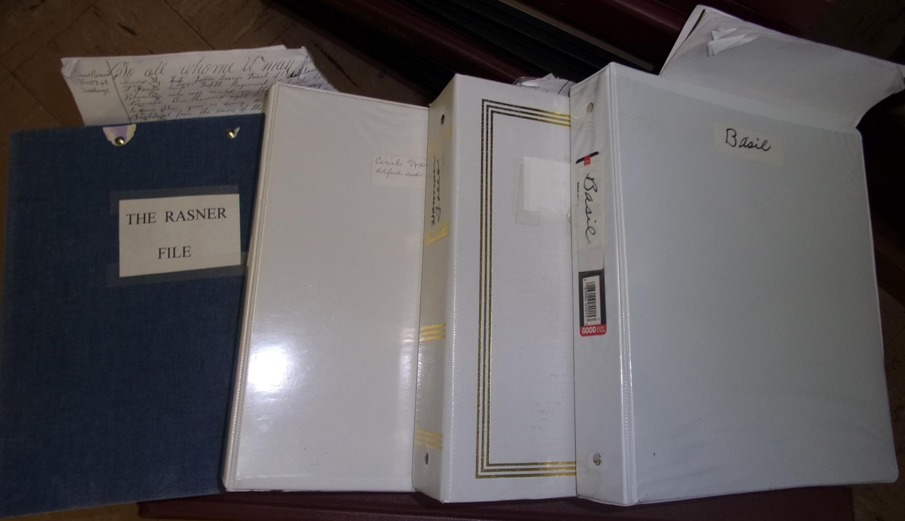
Binders
A method where 3-ring binders and document sleeves are used to organize genealogical documents and ephemera

Slide 30
Binders
A method where 3-ring binders and document sleeves are used to organize genealogical documents and ephemera
The binders are usually labeled by surname

Slide 31
Binders
A method where 3-ring binders and document sleeves are used to organize genealogical documents and ephemera
The binders are usually labeled by surname
Within the binder, the documents are arranged by document type

Slide 32
Binders
A method where 3-ring binders and document sleeves are used to organize genealogical documents and ephemera
The binders are usually labeled by surname
Within the binder, the documents are arranged by document type
A great organizational method for beginners and those that find this method useful for them

Slide 33
Binders
A method where 3-ring binders and document sleeves are used to organize genealogical documents and ephemera
The binders are usually labeled by surname
Within the binder, the documents are arranged by document type
A great organizational method for beginners and those that find this method useful for them
Lay binders flat when storing them on shelves

Slide 34
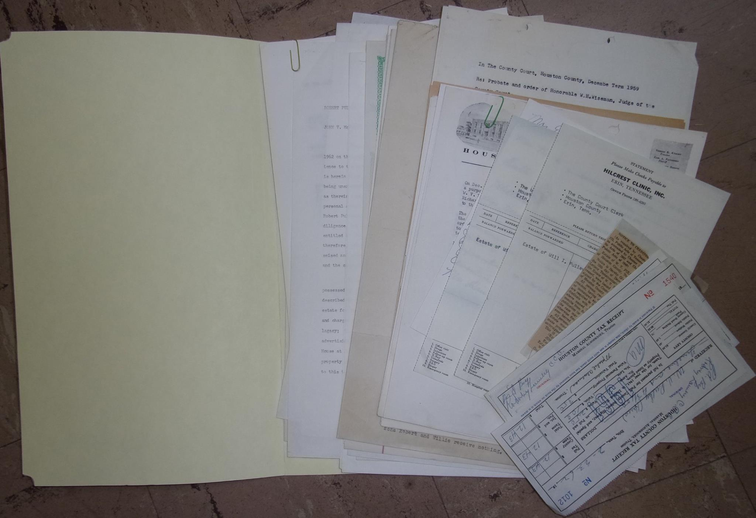
Folders
A method where documents and ephemera for an individual person are filed in folders and those folders are stored in filing cabinets or boxes

Slide 35
Folders
A method where documents and ephemera for an individual person are filed in folders and those folders are stored in filing cabinets or boxes
Arranged in filing cabinets or boxes by surname

Slide 36
Folders
A method where documents and ephemera for an individual person are filed in folders and those folders are stored in filing cabinets or boxes
Arranged in filing cabinets or boxes by surname
Archives use the folder method when organizing their Vertical Files Collections

Slide 37
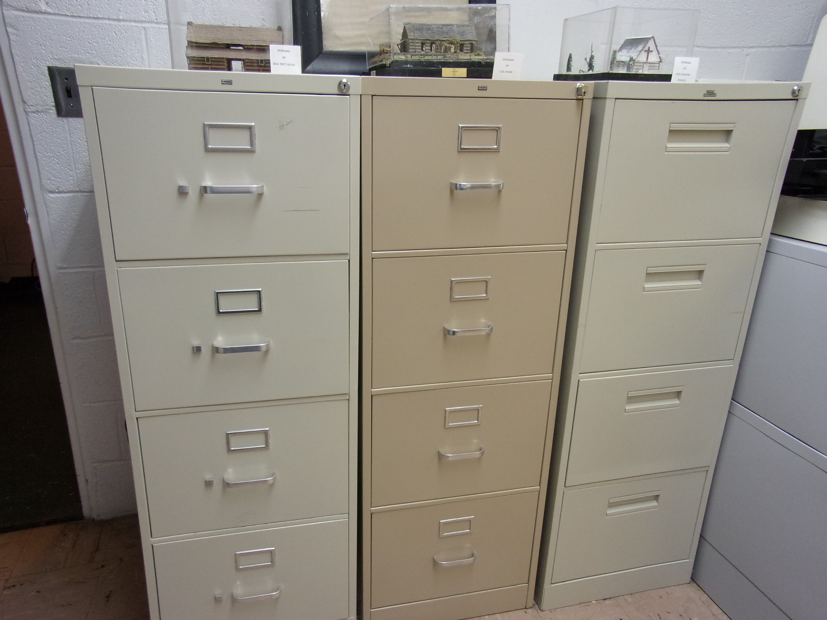
Vertical Files, Houston County Archives & Museum

Slide 38
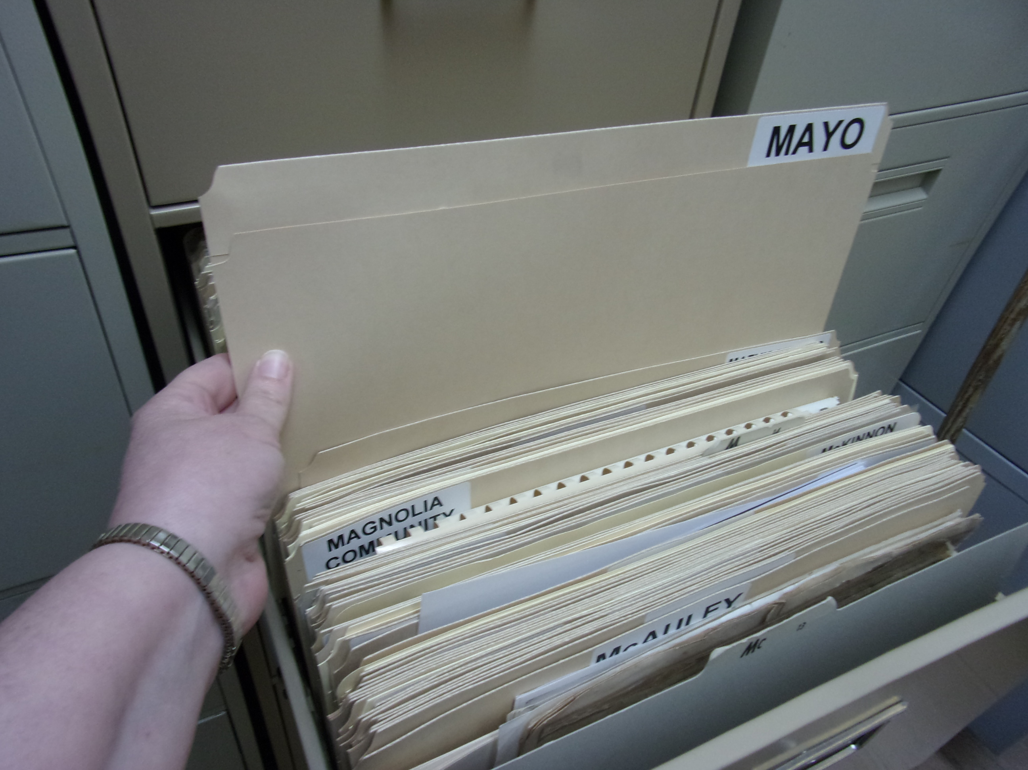
Surnames in Vertical Files, Houston County Archives & Museum

Slide 39
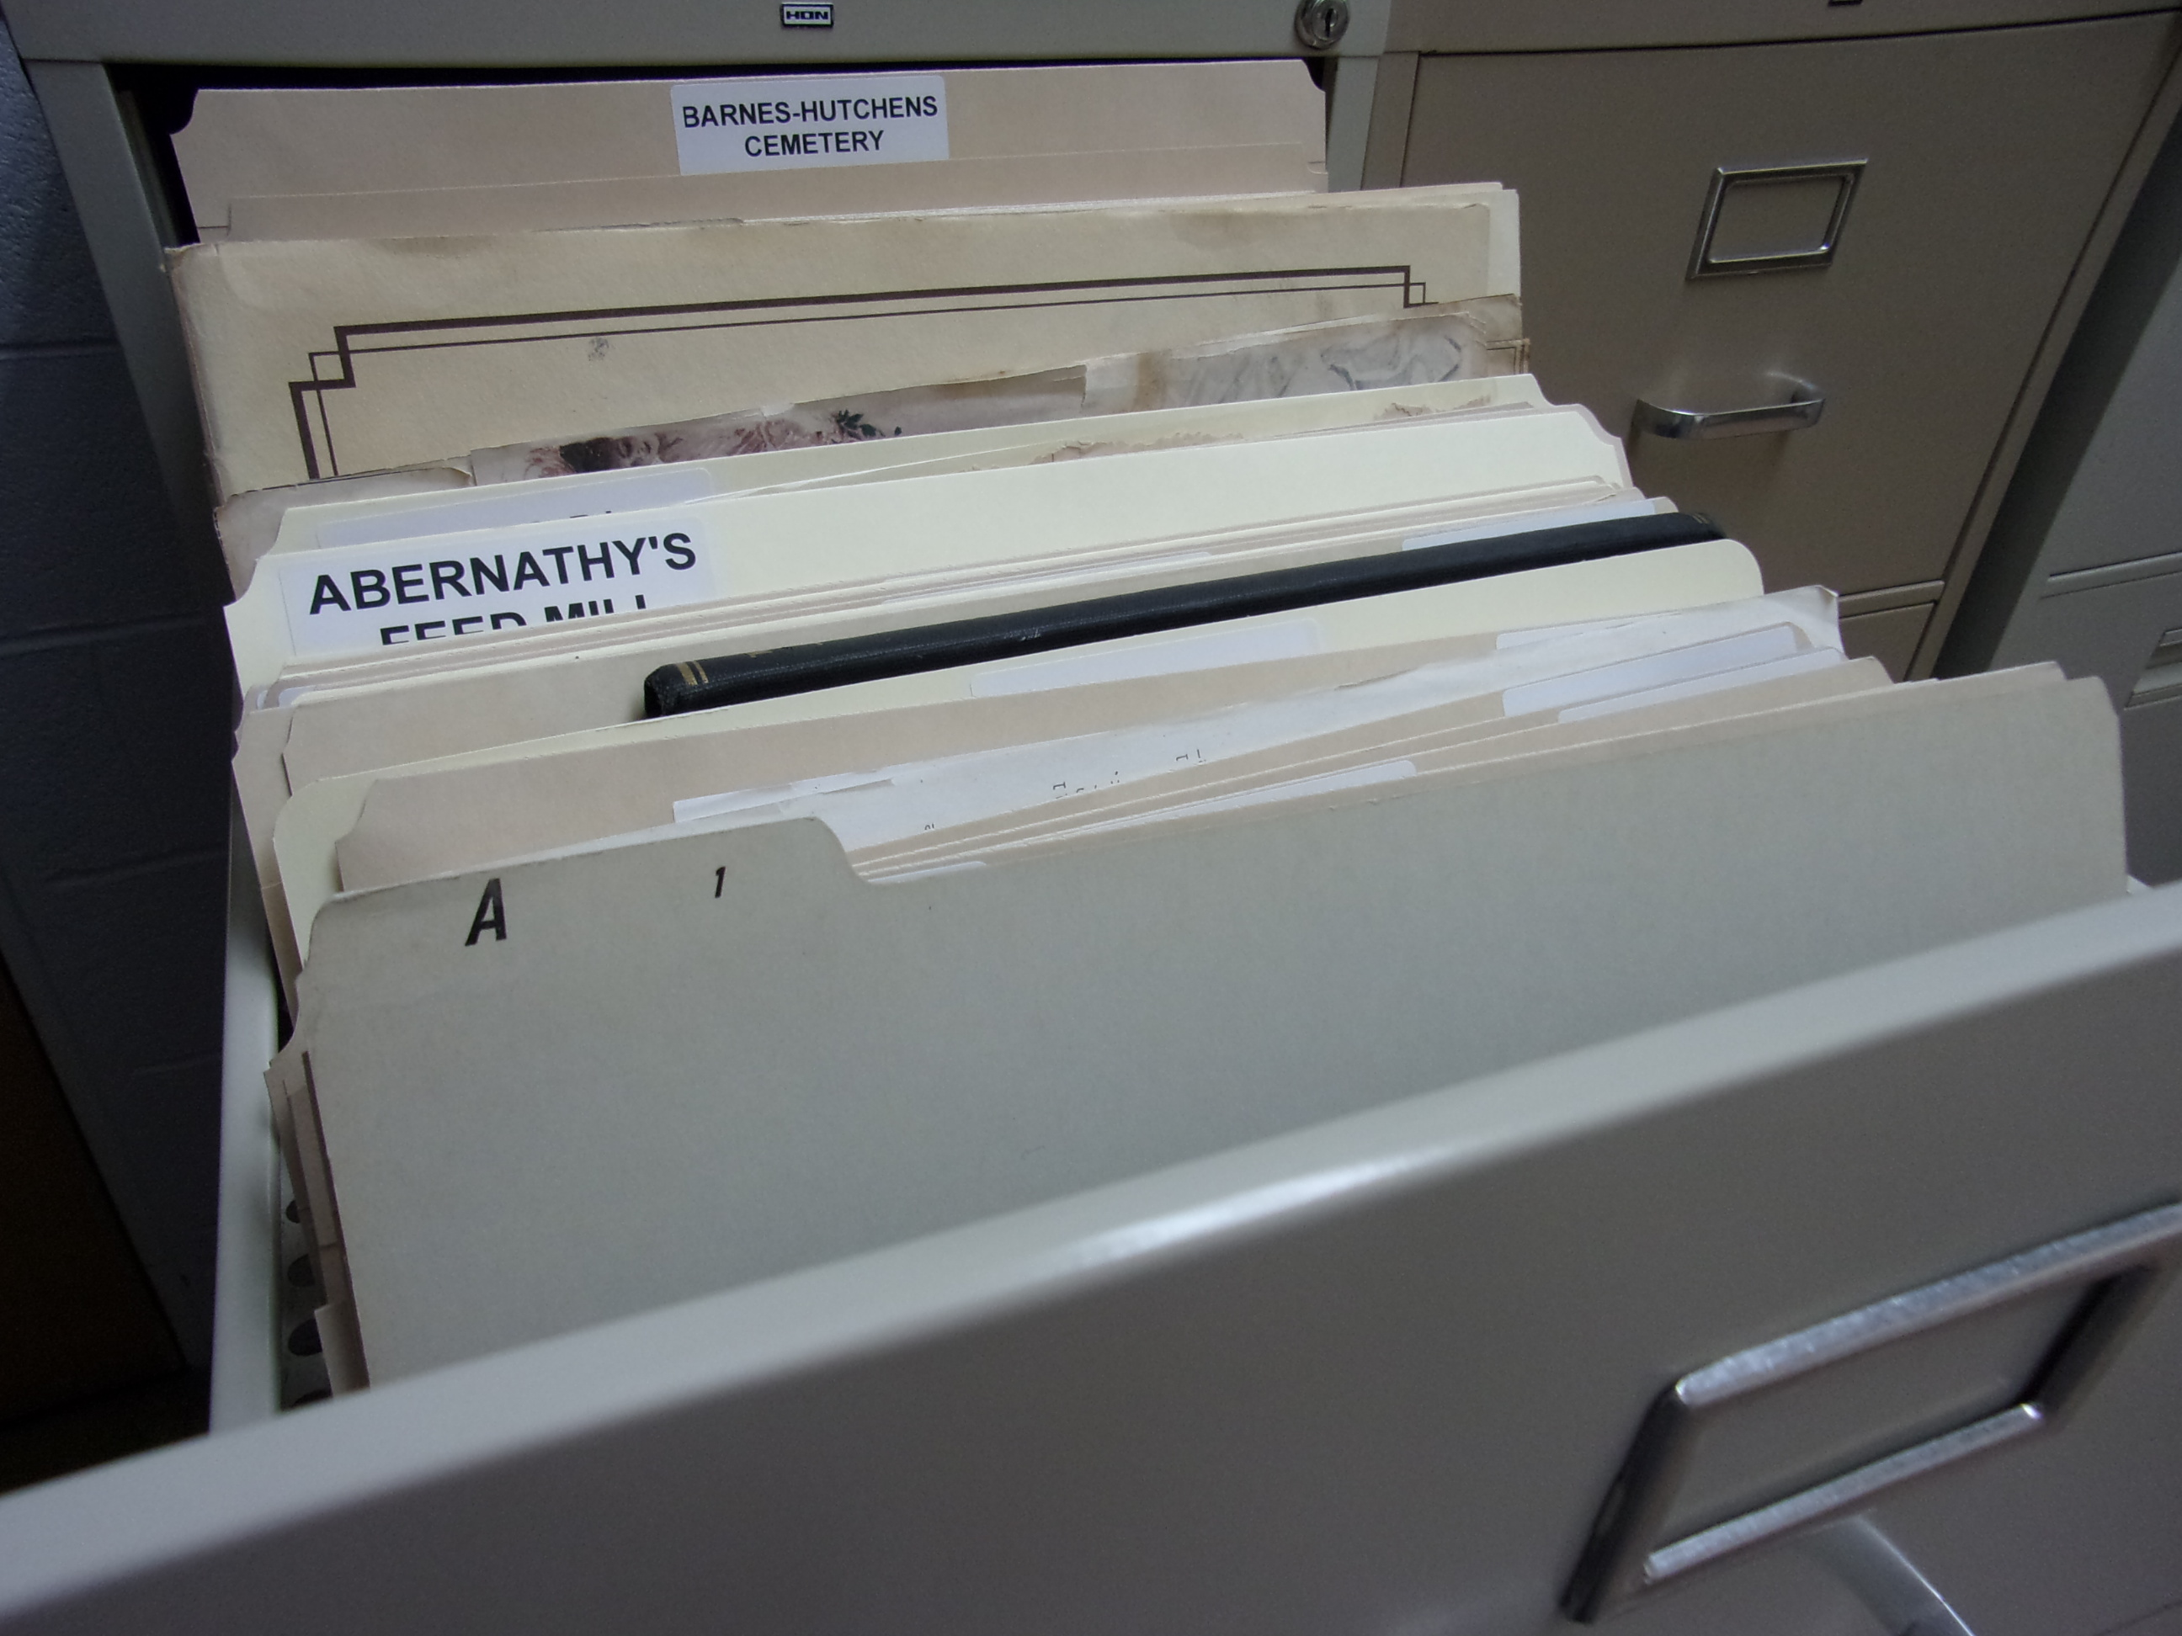
Subject Names in Vertical Files

Slide 40
Folders
A method where documents and ephemera for an individual person are filed in folders and those folders are stored in filing cabinets or boxes
Arranged in filing cabinets or boxes by surname
Archives use the folder method when organizing their Vertical Files Collections
Need to have room for filing cabinets, they will fill up!

Slide 41
Unfolding and Flattening Records

Slide 42
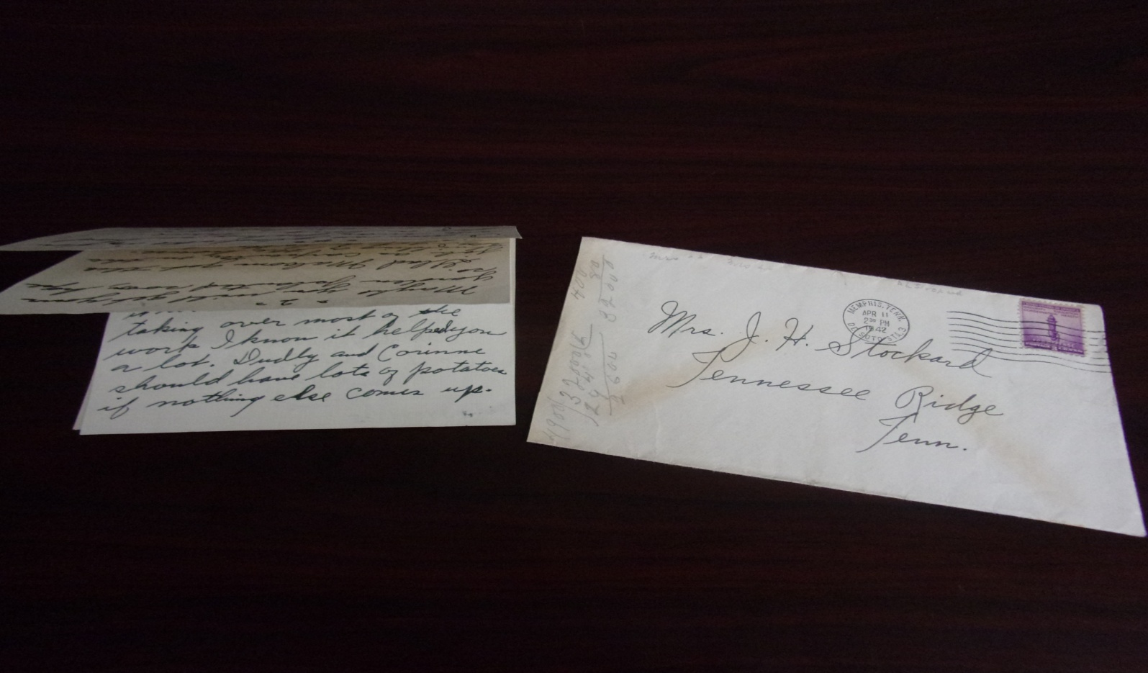
Unfolding and Flattening Records
This is the first step an archives takes when processing documents and ephemera

Slide 43
Unfolding and Flattening Records
This is the first step an archives takes when processing documents and ephemera
Home Archivist should also carefully unfold and flatten their family documents

Slide 44
Unfolding and Flattening Records
This is the first step an archives takes when processing documents and ephemera
Home Archivist should also carefully unfold and flatten their family documents
The crease lines in folded documents can eventually fail and cause the document to tear apart

Slide 45
Unfolding and Flattening Records
This is the first step an archives takes when processing documents and ephemera
Home Archivist should also carefully unfold and flatten their family documents
The crease lines in folded documents can eventually fail and cause the document to tear apart
Archiving documents that are flattened will be less likely to sustain damage in the long run

Slide 46
Cleaning Records

Slide 47
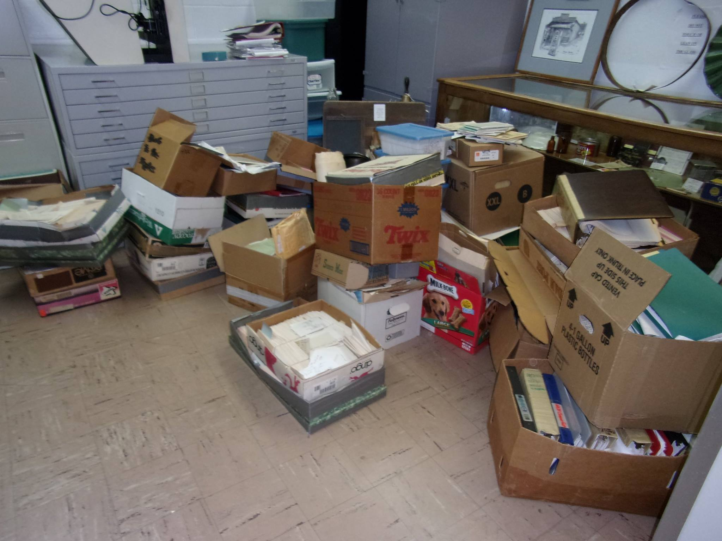
Cleaning Records
Some records come to us at the archives dirty, maybe you have dirty records too
County Historian, Nina Finley (1935-2014), Records Collection

Slide 48
Cleaning Records
Some records come to us at the archives dirty, maybe you have dirty records too
Soot, dust and other grime could be on your documents and ephemera

Slide 49
Cleaning Records
Some records come to us at the archives dirty, maybe you have dirty records too
Soot, dust and other grime could be on your documents and ephemera
Cleaning documents and ephemera should be done gently

Slide 50
Cleaning Records
Some records come to us at the archives dirty, maybe you have dirty records too
Soot, dust and other grime could be on your documents and ephemera
Cleaning documents and ephemera should be done gently
Use the right tools from your Home Archivist Tool Kit (pages 61-64 in course syllabus)

Slide 51
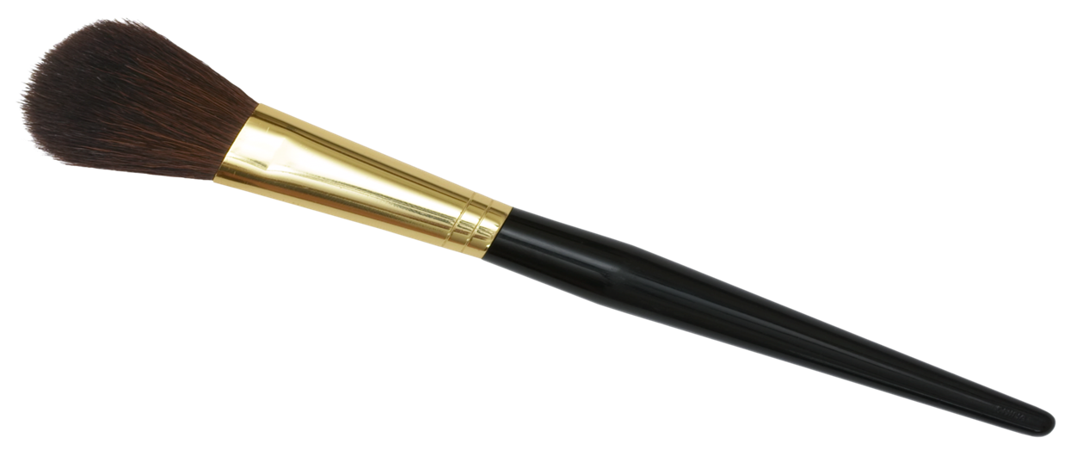
Soft Brushes
Use soft bristle brushes to brush off dust and dirt from documents

Slide 52
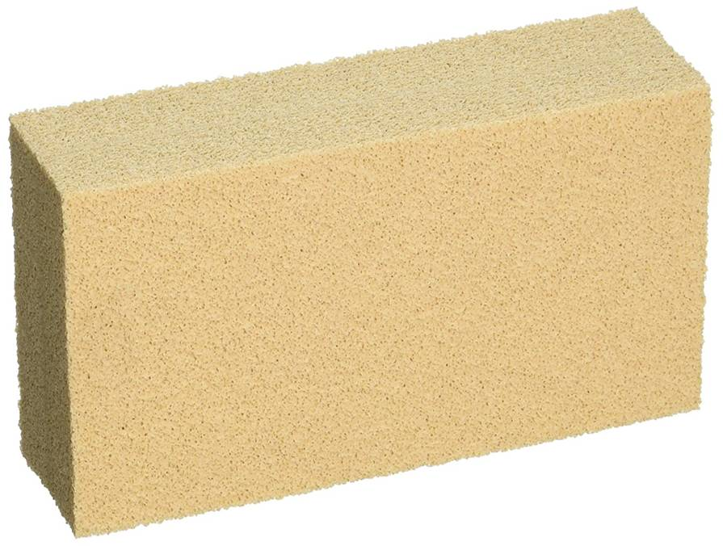
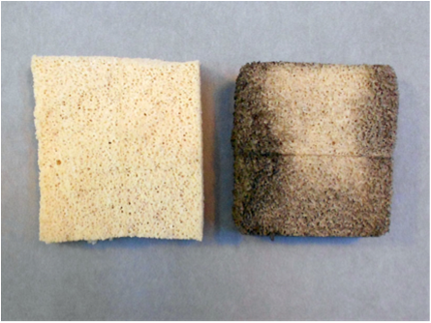
Soot and Dirt Cleaning Sponges

Slide 53
Soot and Dirt Cleaning Sponges
Place document on a clean, flat, sturdy surface

Slide 54
Soot and Dirt Cleaning Sponges
Place document on a clean, flat, sturdy surface
Place hand in the middle of the document

Slide 55
Soot and Dirt Cleaning Sponges
Place document on a clean, flat, sturdy surface
Place hand in the middle of the document
Using the sponge, wipe from the middle of the document out to the edges

Slide 56
Soot and Dirt Cleaning Sponges
Place document on a clean, flat, sturdy surface
Place hand in the middle of the document
Using the sponge, wipe from the middle of the document out to the edges
Work in small areas at a time

Slide 57
Soot and Dirt Cleaning Sponges
Place document on a clean, flat, sturdy surface
Place hand in the middle of the document
Using the sponge, wipe from the middle of the document out to the edges
Work in small areas at a time
DO NOT USE ON PENCIL WRITING!

Slide 58
Removing Hazard from Documents and Ephemera

Slide 59
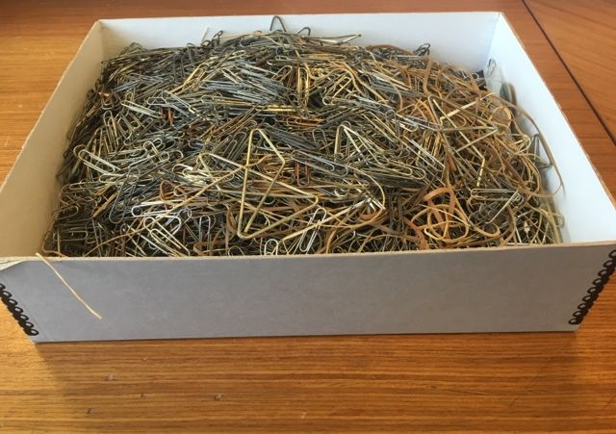
Removing Hazards from Documents and Ephemera
Archives remove all metal from documents and ephemera
Hazards removed from documents and ephemera
Houston County, TN. Archives & Museum

Slide 60
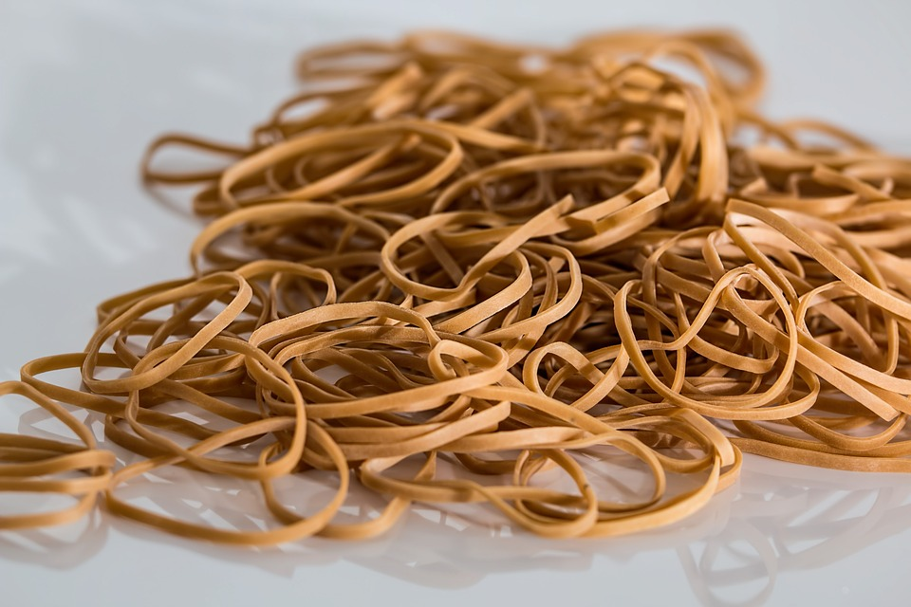
Removing Hazards from Documents and Ephemera
Archives remove all metal from documents and ephemera
Archives remove all rubber bands from documents and ephemera

Slide 61
Removing Hazards from Documents and Ephemera
Archives remove all metal from documents and ephemera
Archives remove all rubber bands from documents and ephemera
Archives remove all tape from documents and ephemera

Slide 62
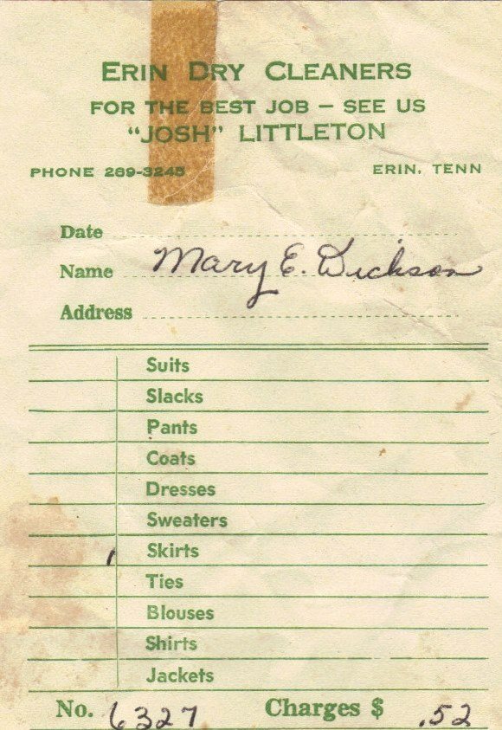
Example of tape damage
Houston County, TN. Archives & Museum

Slide 63
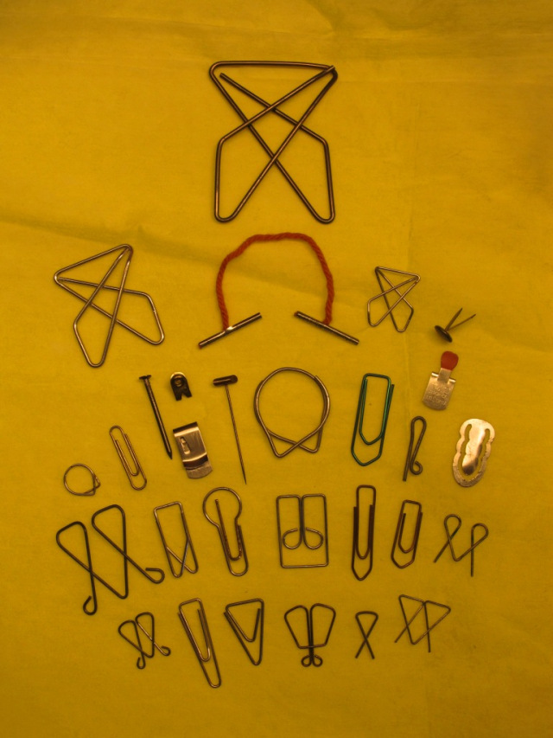
Removing All Metal
Staples
Paper Clips
Straight Pins
Grommets
Hair Pins
Binding Clips
Any and all metal fasteners

Slide 64
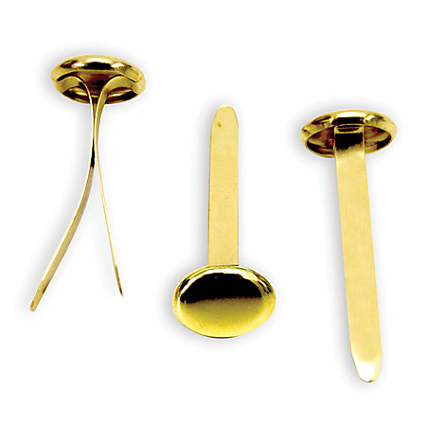
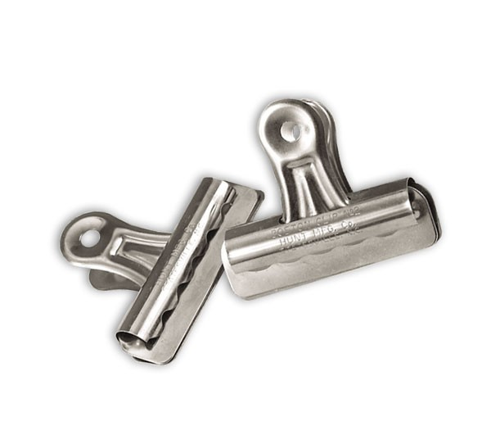
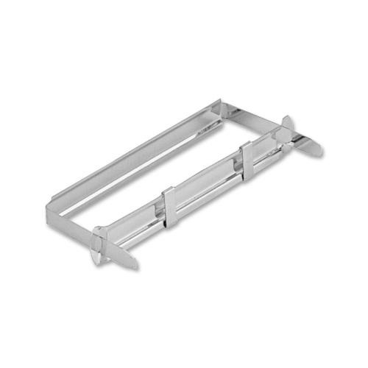
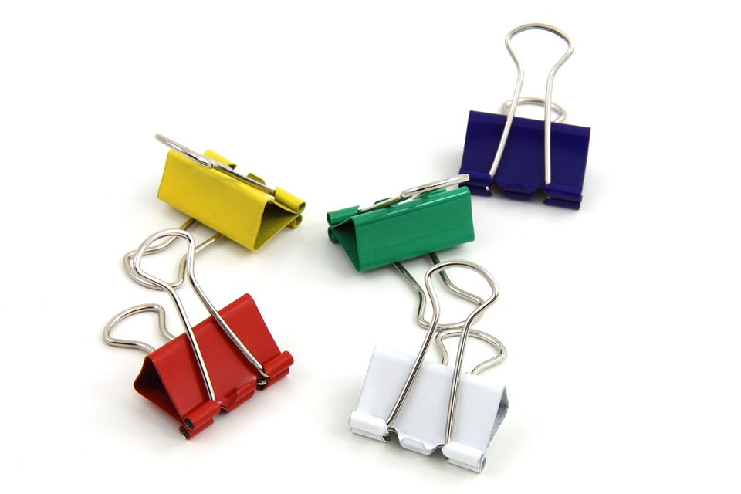

Slide 65
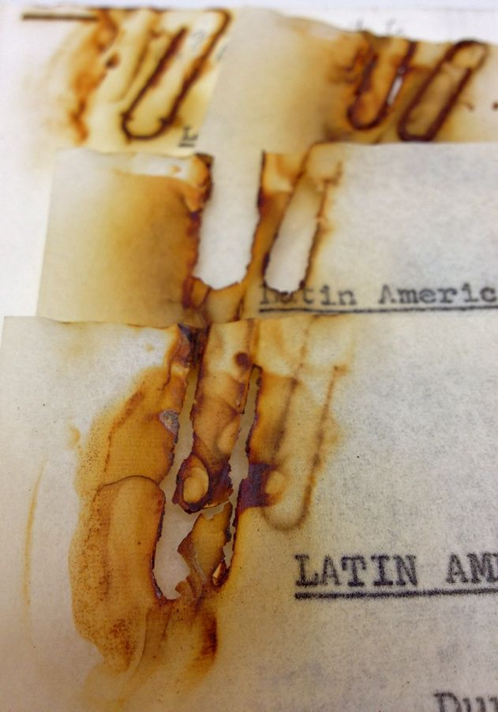
Example of metal paper clip damage

Slide 66
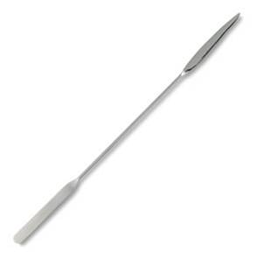
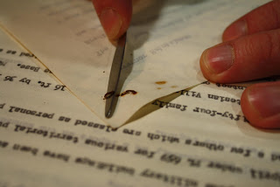
Micro Spatula
Removing a metal staple

Slide 67
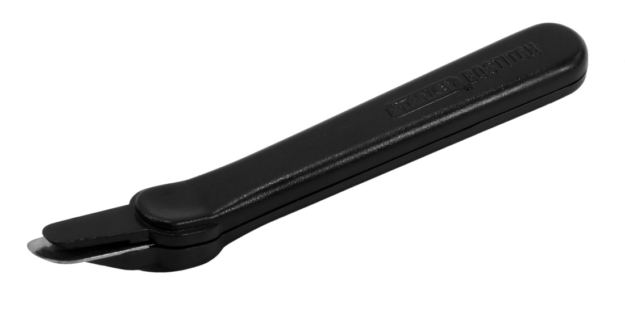
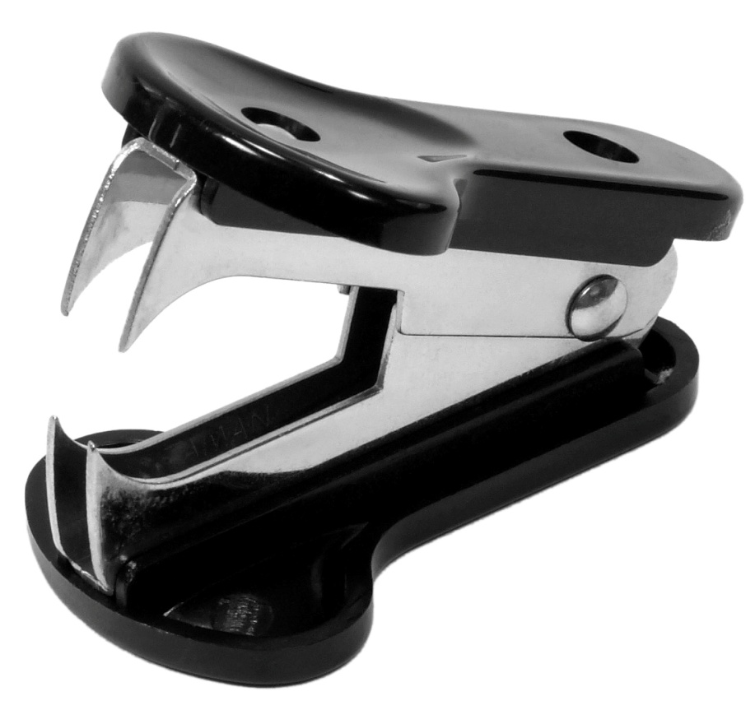
Do Not Use
Claw Staple Remover
Wand Staple Remover

Slide 68
Removing Things That Bind

Slide 69
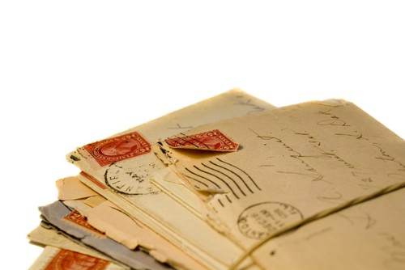
Removing Things That Bind
Rubber Bands
Twine
Rope
Shoestrings
Hair Ribbons
Band-Aids
Letters bound with a rubber band

Slide 70
Removing Things That Bind
Items that bind documents together can damage the documents

Slide 71
Removing Things That Bind
Items that bind documents together can damage the documents
Rubber bands can deteriorate to the point of sticking to the documents

Slide 72
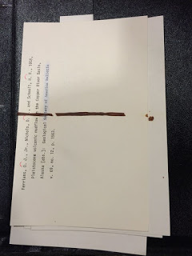
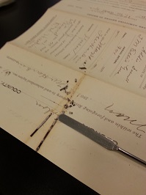
Using a Micro Spatula
Rubber band stuck to documents

Slide 73
Removing Things That Bind
Items that bind documents together can damage the documents
Rubber bands can deteriorate to the point of sticking to the documents
Twine, Rope, Shoestrings can damage documents if not removed

Slide 74
Removing Things That Bind
Items that bind documents together can damage the documents
Rubber bands can deteriorate to the point of sticking to the documents
Twine, Rope, Shoestrings can damage documents if not removed
Hair Ribbons can be removed and then archived with the documents as a family heirloom or keepsake

Slide 75
Removing Tape

Slide 76
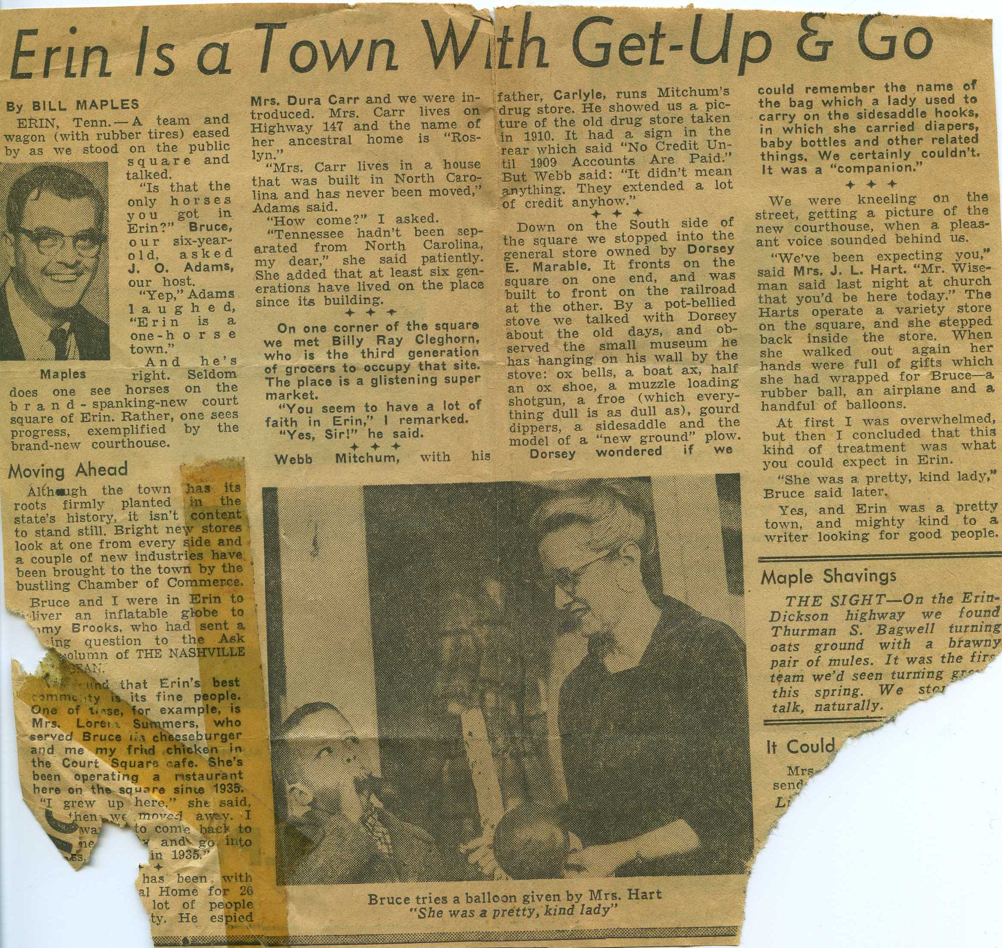
Removing Tape
Removing tape can be very difficult

Slide 77
Removing Tape
Removing tape can be very difficult
If the tape has become hard and brittle it should just come right off

Slide 78
Removing Tape
Removing tape can be very difficult
If the tape has become hard and brittle it should just come right off
If the tape has adhered to the document and has become “gummy” it would be best to leave it alone or contact a records conservator

Slide 79
Removing Tape
Removing tape can be very difficult
If the tape has become hard and brittle it should just come right off
If the tape has adhered to the document and has become “gummy” it would be best to leave it alone or contact a records conservator
If tape is attaching documents together like a paper clip, use scissors to cut the tape and separate the documents

Slide 80
What Is Safe To Use?

Slide 81
Plastic Paper Clips

Slide 82
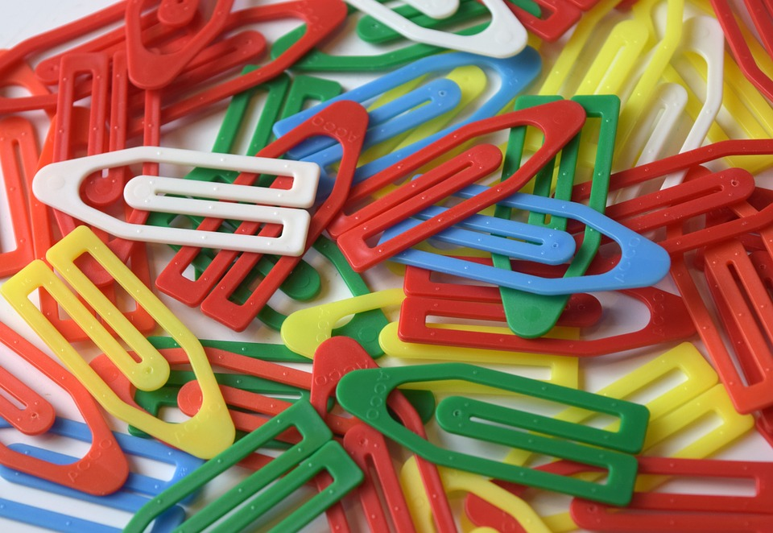
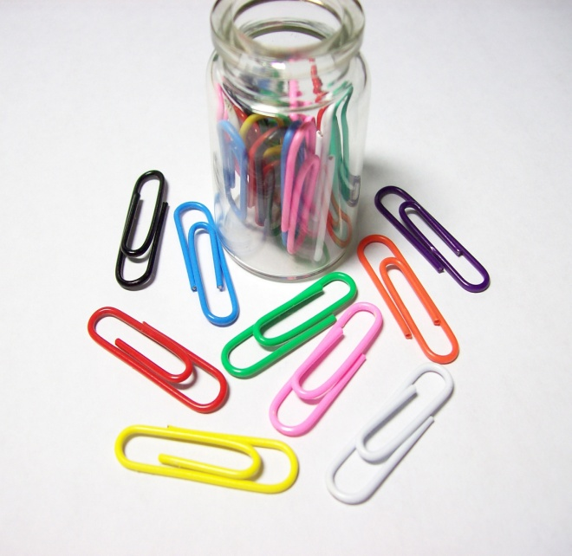
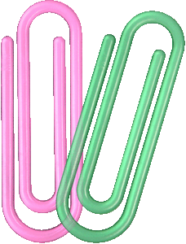
Plastic Paper Clips or Plastic-Coated Paper Clips

Slide 83
Archival Tape

Slide 84
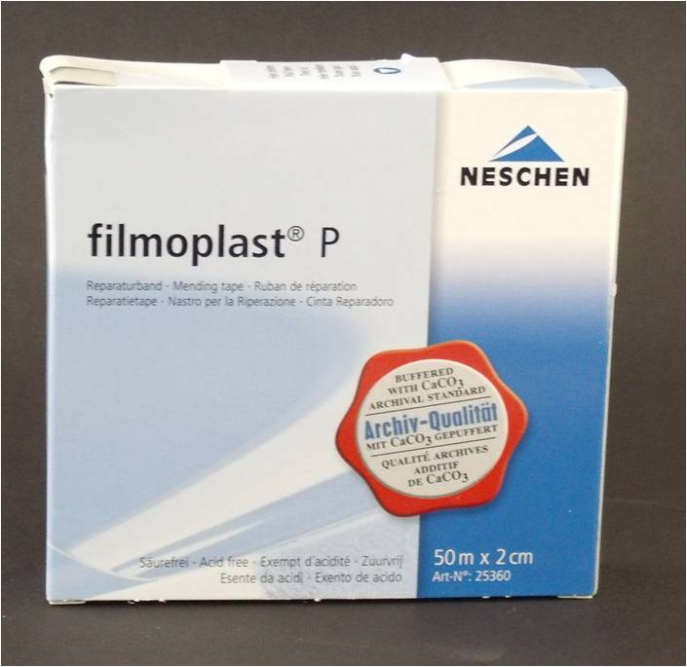
Archival Tape
A great tool to repair small rips or tears in documents and ephemera

Slide 85
Archival Tape
A great tool to repair small rips or tears in documents and ephemera
Should be used sparingly

Slide 86
Archival Tape
A great tool to repair small rips or tears in documents and ephemera
Should be used sparingly
Apply the tape on the back of the document where there is no writing, if possible

Slide 87
Archival Tape
A great tool to repair small rips or tears in documents and ephemera
Should be used sparingly
Apply the tape on the back of the document where there is no writing, if possible
For severely damaged documents, contact a conservator

Slide 88
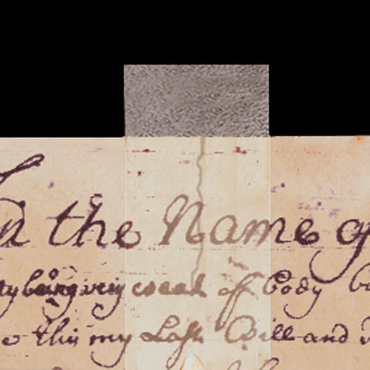
Using Archival Repair Tape for Small Tears

Slide 89
An Experiment

Slide 90
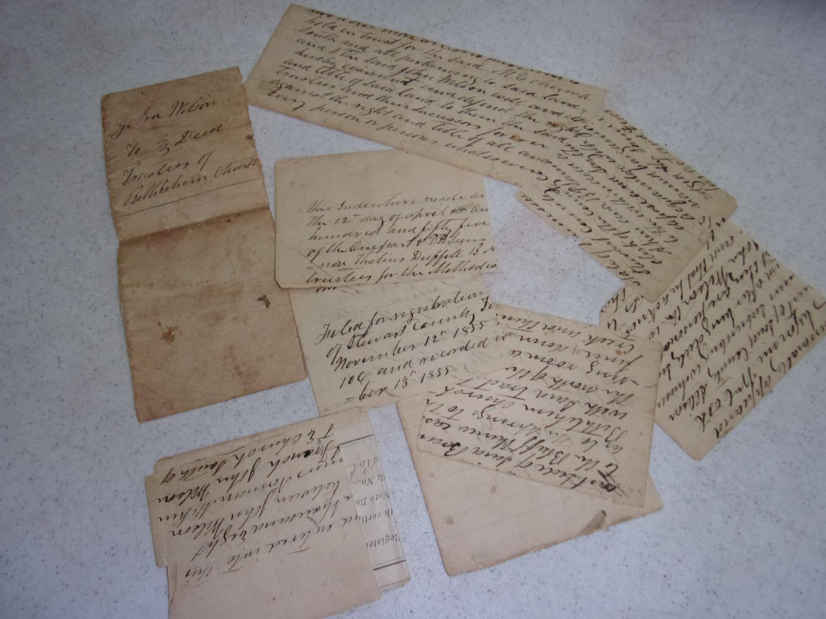
Deed: John Wilson to Trustees of Bethlehem Church, April 12, 1854, Houston County Archives & Museum

Slide 91
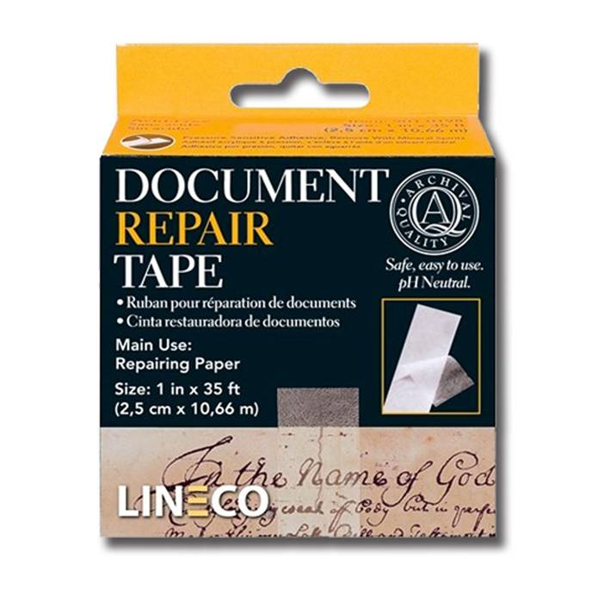

Slide 92
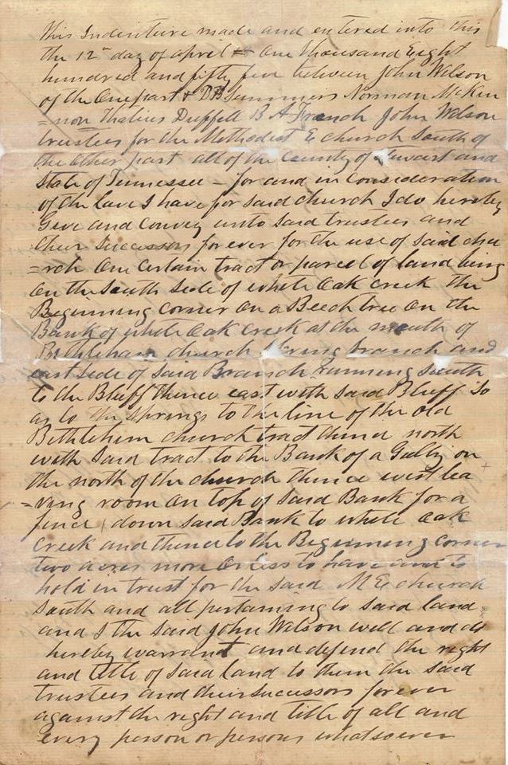

Slide 93
Records Storage

Slide 94
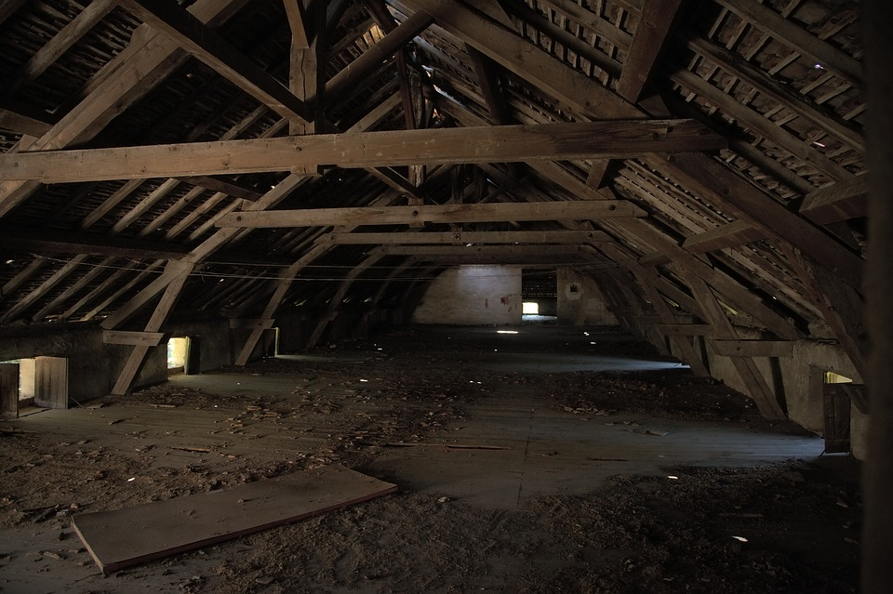
Records Storage
Do not store records in an attic, basement or garage

Slide 95
Records Storage
Do not store records in an attic, basement or garage
Store records in a dry environment off the floor

Slide 96
Records Storage
Do not store records in an attic, basement or garage
Store records in a dry environment off the floor
Store records in an area where the temperatures are consistent and do not fluctuate

Slide 97
Records Storage
Do not store records in an attic, basement or garage
Store records in a dry environment off the floor
Store records in an area where the temperatures are consistent and do not fluctuate
Keep all records out of direct sunlight

Slide 98
Climate Controls

Slide 99
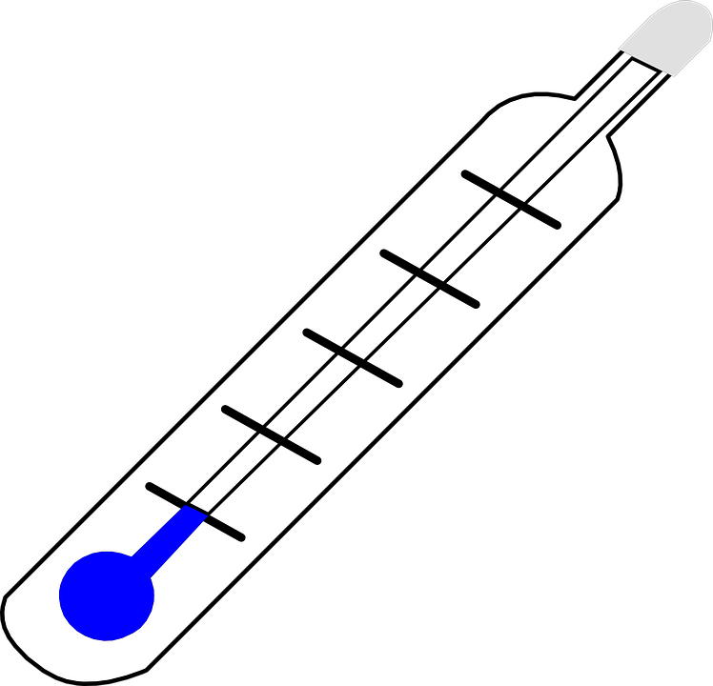
Climate Controls
Temperatures should stay at a steady 35-65 degrees Fahrenheit, the cooler the better

Slide 100
Climate Controls
Temperatures should stay at a steady 35-65 degrees Fahrenheit, the cooler the better
Humidity levels should be between 30%-50%, choose a level and keep it there consistently

Slide 101
Climate Controls
Temperatures should stay at a steady 35-65 degrees Fahrenheit, the cooler the better
Humidity levels should be between 30%-50%, choose a level and keep it there consistently
Consistent temperature and humidity levels will slow document deterioration

Slide 102
Climate Controls
Temperatures should stay at a steady 35-65 degrees Fahrenheit, the cooler the better
Humidity levels should be between 30%-50%, choose a level and keep it there consistently
Consistent temperature and humidity levels will slow document deterioration
Consider purchasing a temperature/humidity monitor for your storage area to keep track of the numbers

Slide 103
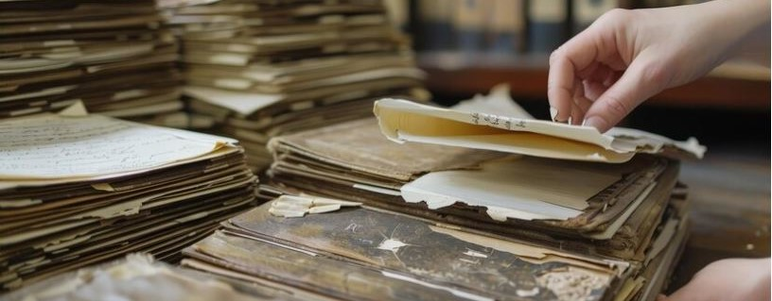
Documents and Ephemera Stored in an Attic, Houston County Archives & Museum

Slide 104
Consulting with a Conservator

Slide 105
Consulting with a Conservator
When you don’t feel comfortable repairing your own documents and ephemera

Slide 106
Consulting with a Conservator
When you don’t feel comfortable repairing your own documents and ephemera
When documents, photographs and artifacts have extensive damage

Slide 107
Consulting with a Conservator
When you don’t feel comfortable repairing your own documents and ephemera
When documents, photographs and artifacts have extensive damage
When documents and ephemera are rare, extremely historical or one-of-a-kind

Slide 108
Locating a Conservator
State Archives

Slide 109

Locating a Conservator
State Archives
American Institute for Conservation of Historic and Artistic Works

Slide 110
Parting Advice……
Do Not Do Anything to Your Records That You Can’t Undo!

Slide 111
THANK YOU!

